Slide 1







Softversko inženjerstvo
Three.js
Dr. Janoš Šimon
simon@vts.su.ac.rs
VISOKA TEHNIČKA ŠKOLA STRUKOVNIH STUDIJA U SUBOTICI
VISOKA TEHNIČKA ŠKOLA STRUKOVNIH STUDIJA U SUBOTICI | SZABADKAI MŰSZAKI SZAKFŐISKOLA | SUBOTICA TECH
24000 SUBOTICA, MARKA OREŠKOVIĆA 16
http://www.vts.su.ac.rs/

Slide 2

Three.js
Three.js je JavaScript biblioteka i interfejs za programiranje aplikacija (API) koji se koristi za kreiranje i prikaz animirane 3D računarske grafike u web pretraživaču pomoću WebGL-a. Izvorni kod je smešten na GitHub.
Three.js omogućava stvaranje 3D animacija ubrzanih grafičkom jedinicom (GPU) koristeći JavaScript jezik kao deo web stranice.
Ricardo Cabello je Three.js prvi put objavio za GitHub u aprilu 2010.
https://threejs.org/

Slide 3
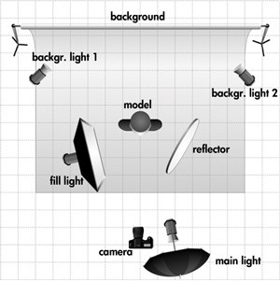
Three.js
U našem 3D svetu imaćemo sledeće elemente:
Scena
Renderer
Kamera
Objekat ili više objekta (sa materijalima)

Slide 4
Index.html
<!DOCTYPE html>
<html>
<head>
<meta charset=utf-8>
<title>My first three.js app</title>
<style>
body { margin: 0; }
canvas { width: 100%; height: 100% }
</style>
</head>
<body>
<script src="js/three.js"></script>
<script>
// Our Javascript will go here.
</script>
</body>
</html>

Slide 5
Prvi primer
Sledeći kod kreira scenu, dodaje kameru i kocku na scenu, kreira WebGL prikazivač i dodaje svoj prikaz u element document. body. Jednom učitana, kocka se okreće oko svoje ose x i y.

Slide 6
Creating the scene
var scene = new THREE.Scene();
var camera = new THREE.PerspectiveCamera( 75, window.innerWidth / window.innerHeight, 0.1, 1000 );
var renderer = new THREE.WebGLRenderer();
renderer.setSize( window.innerWidth, window.innerHeight );
document.body.appendChild( renderer.domElement );
var geometry = new THREE.BoxGeometry( 1, 1, 1 );
var material = new THREE.MeshBasicMaterial( { color: 0x00ff00 } );
var cube = new THREE.Mesh( geometry, material );
scene.add( cube );
camera.position.z = 5;

Slide 7
Rendering the scene
function animate() {
requestAnimationFrame( animate );
renderer.render( scene, camera );
}
animate();

Slide 8
Animating the cube
cube.rotation.x += 0.1;
cube.rotation.y += 0.1;

Slide 9
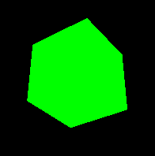
The result – all in one
<html>
<head>
<title>My first three.js app</title>
<style>
body { margin: 0; }
canvas { width: 100%; height: 100% }
</style>
</head>
<body>
<script src="js/three.js"></script>
<script>
var scene = new THREE.Scene();
var camera = new THREE.PerspectiveCamera( 75, window.innerWidth/window.innerHeight, 0.1, 1000 );
var renderer = new THREE.WebGLRenderer();
renderer.setSize( window.innerWidth, window.innerHeight );
document.body.appendChild( renderer.domElement );
var geometry = new THREE.BoxGeometry( 1, 1, 1 );
var material = new THREE.MeshBasicMaterial( { color: 0x00ff00 } );
var cube = new THREE.Mesh( geometry, material );
scene.add( cube );
camera.position.z = 5;
var animate = function () {
requestAnimationFrame( animate );
cube.rotation.x += 0.1;
cube.rotation.y += 0.1;
renderer.render(scene, camera);
};
animate();
</script>
</body>
</html>

Slide 10
Hvala na pažnji

