Slide 1







Softversko inženjerstvo
Proširena stvarnost (Augmented reality)
Dr. Janoš Šimon
simon@vts.su.ac.rs
VISOKA TEHNIČKA ŠKOLA STRUKOVNIH STUDIJA U SUBOTICI
VISOKA TEHNIČKA ŠKOLA STRUKOVNIH STUDIJA U SUBOTICI | SZABADKAI MŰSZAKI SZAKFŐISKOLA | SUBOTICA TECH
24000 SUBOTICA, MARKA OREŠKOVIĆA 16
http://www.vts.su.ac.rs/

Slide 2

Proširena stvarnost (Augmented reality)
Proširena stvarnost – termin koji opisuje realnu sliku dopunjenu kompjuterski generisanim tekstom, slikom i zvukom. AR aplikacije omogućavaju inovativan pristup korisnicima kroz povezivanje štampanih medija i predmeta, sa mobilnim aparatima, web aplikacijama i društvenim mrežama.

Slide 3









Naš digitalni svet (Prikupljanje podataka, obogaćivanje okruženja)
Artificial Intelligence
Pattern Matching
Predictions
Trends
Key requirements
Easy and quick addition
of configurable workflow
Automated and reliable
Traceable
Secure
Temp/Flow/Vibration
Maintenance
Location
Personnel
Inventory/RFID
POS data
RFID
Cust loyalty
Beacon
marketing
GPS
Telemetry
Video
Temperature
Maintenance
Contents
New Business Model
New experiences
New monetization models
New solutions
New markets
Data Lakes in the Cloud
Technology agnostic
Elastic
Open
Augmented Reality
Enrich environment with related and relevant data

Slide 4
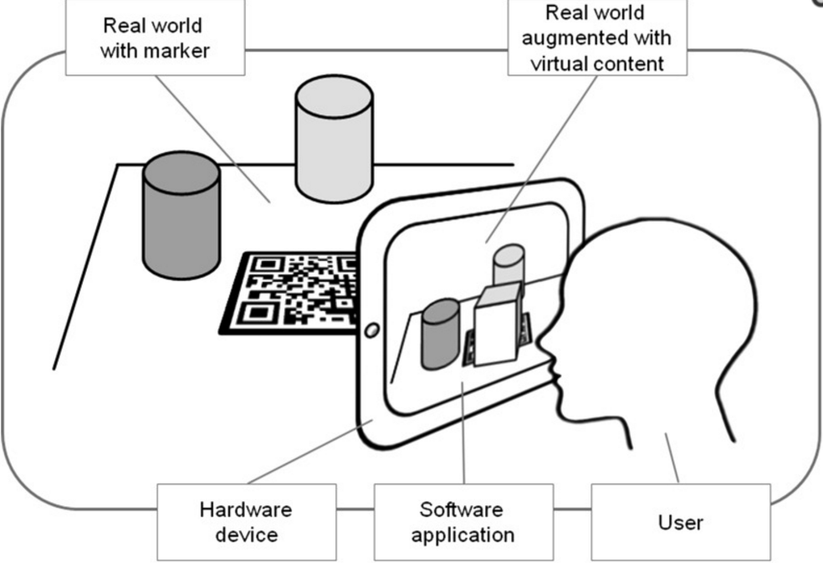
Kako funkcioniše?

Slide 5
Oblasti primene proširene stvarnosti
Virtuelna putovanja, izleti
Pogledajte mesta, prostore i svemir
Virtuelni treninzi (vojska, liderstvo, ostale simulacije)
Pričanje priča
Igre i zabava
Terapija
Marketing
Industrija 4.0

Slide 6
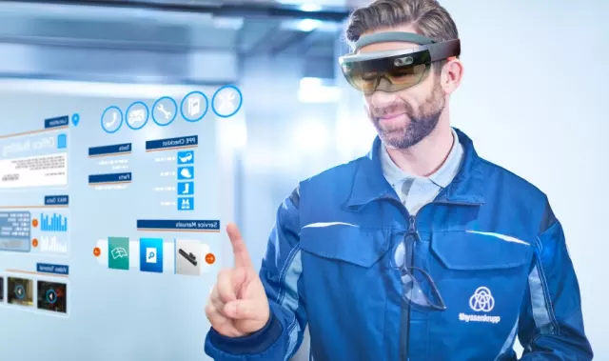
Proširena stvarnost u industriji
Složena instalacija
Proizvodnja i održavanje zgrada
Obuka i stručna podrška
Obezbeđivanje kvaliteta
Automatizacija - kontrola
Dizajn

Slide 7
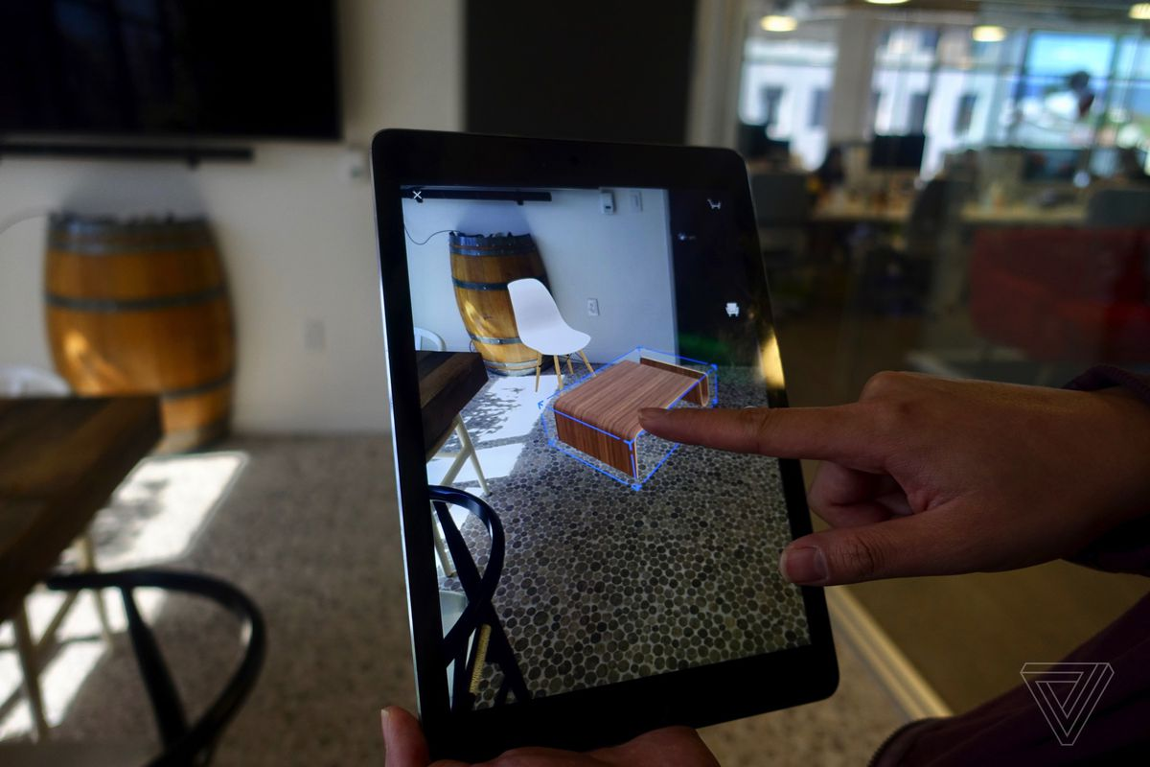
Proširena stvarnost u maloprodaji
Nameštaj
Lepota
Moda
Renoviranje kuće
Oglasi u tradicionalnim medijima
Pametne police za prodavnice

Slide 8

Proširena stvarnost u turizmu
Marketing
Rezervacije hotela
Proširena navigacija
Prevodi jezika
Planiranje obroka i zabave
Odmor možemo pretvoriti u „iskustvo“

Slide 9
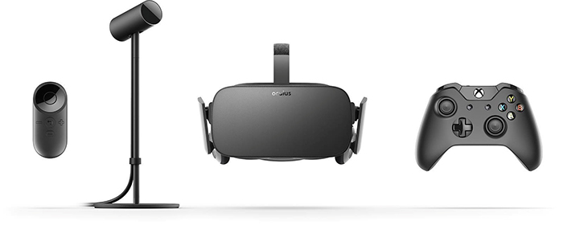
Oculus Rift
Notes:
Rift includes the headset with built-in headphones and mic, sensor, and an Xbox One controller. The controller is perfect for a variety of games, including Lucky’s Tale, the amazing VR platformer developed by Playful, that we’re including free with every Rift. Requires PC computer with specific hardware requirements. graphics card: NVIDIA GTX 970 / AMD R9 290 equivalent or greater
processor: Intel i5-4590 equivalent or greater
memory: 8GB+ RAM
output: Compatible HDMI 1.3 video output
input: 3x USB 3.0 ports plus 1x USB 2.0 port
operating system: Windows 7 SP1 64 bit or newer

Slide 10
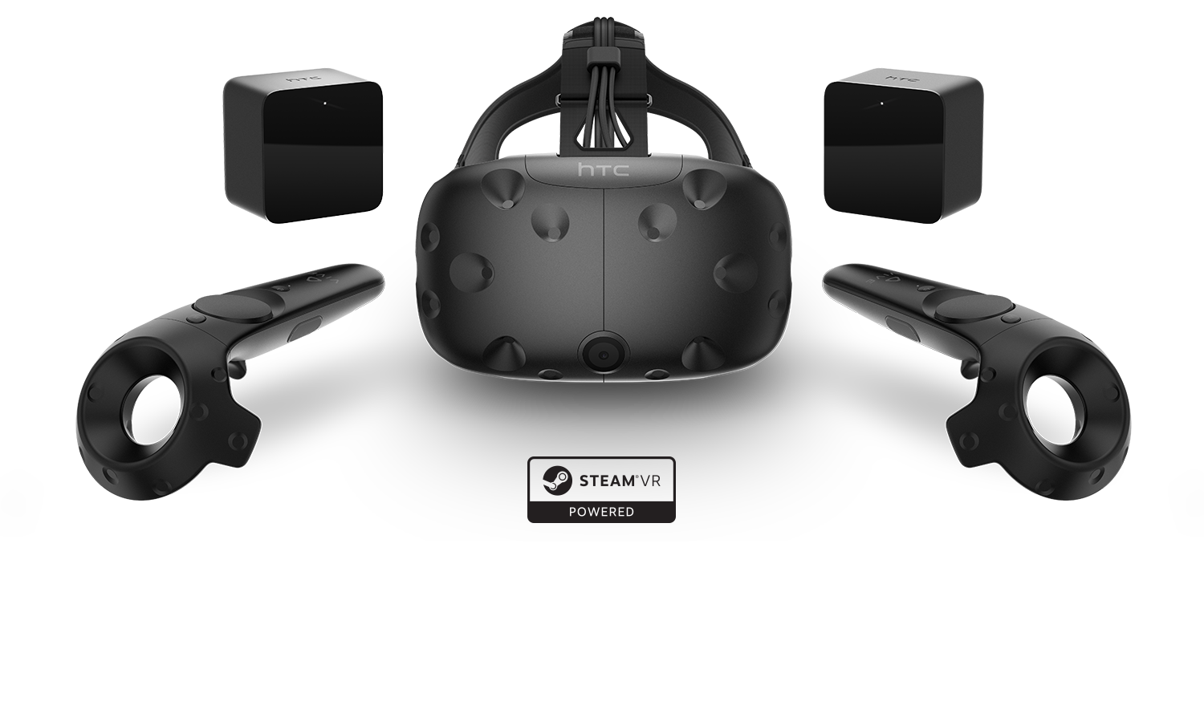
HTC Vive
Notes:
Can order now for $799. Includes headset, two wireless controllers, and two base stations for 360 degrees room-scale motion-tracking. Need optimized PC like with Oculus Rift. Works with Steam entertainment platform.

Slide 11
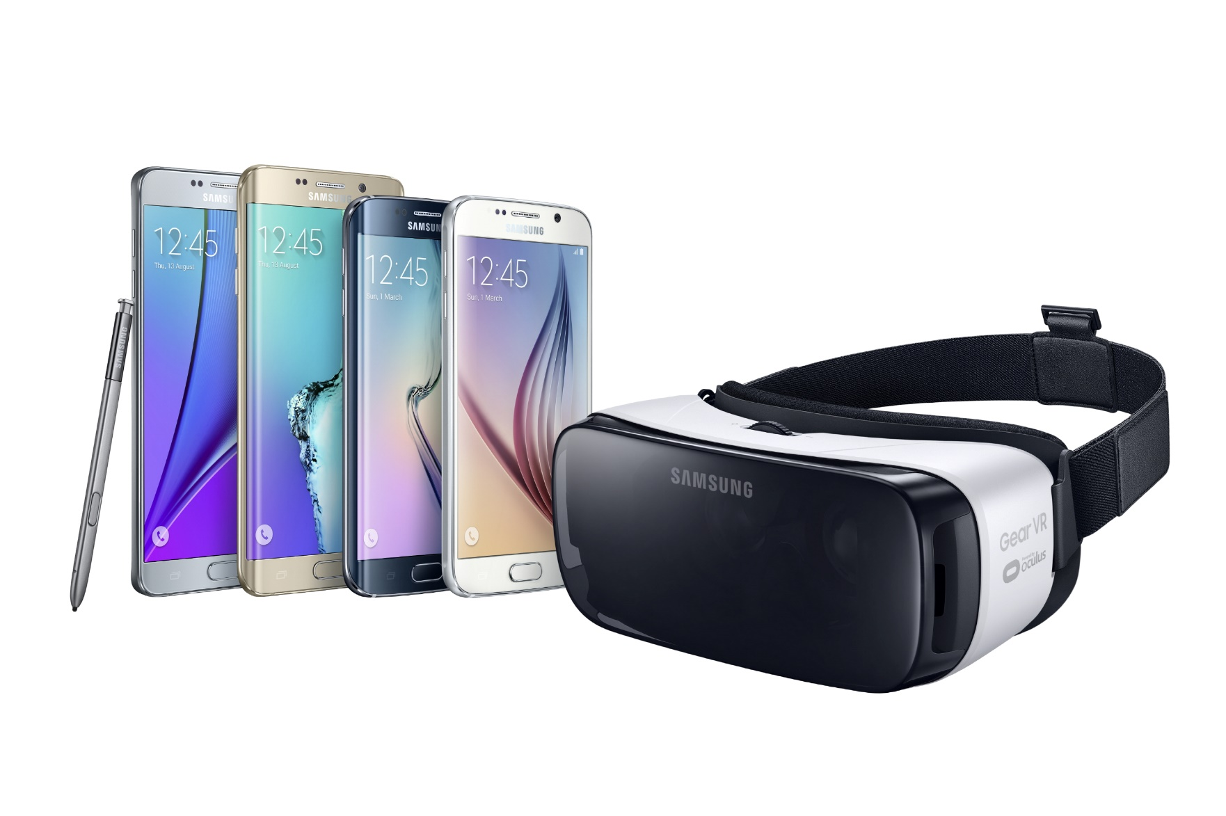
Samsung Gear
Notes:
Powered by Oculus. $99 headset model meant to use with Samsung smartphone. Download VR apps.

Slide 12
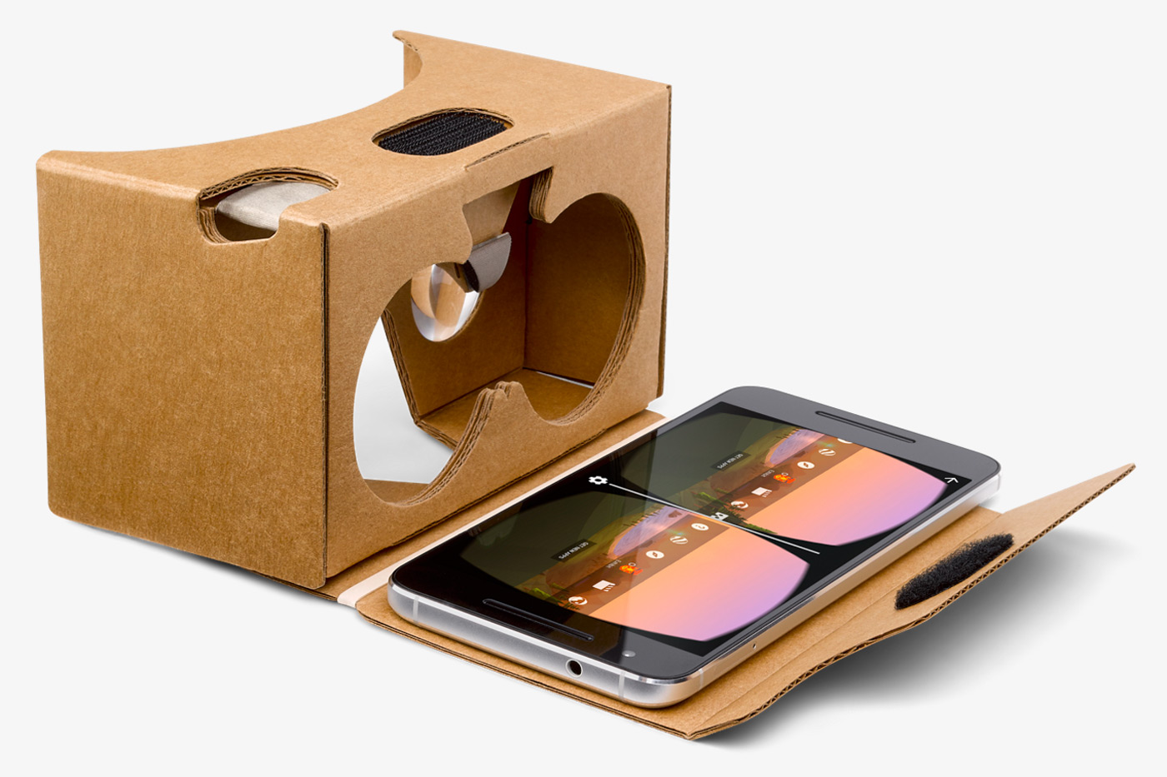
Google Cardboard
Notes:
Least expensive, starting at $15. Uses magnetic controller. Can build your own or purchase. Several Google Cardboard viewers now, including Mattel View-Master that we’ll try later.

Slide 13
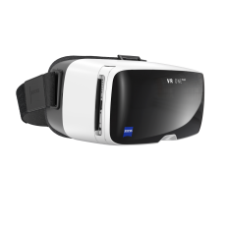
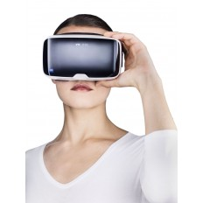
Zeiss VR One and Zeiss VR One GX
Notes:
Headset that works with specific smartphones starting at $129. GX version meant to work with Google Cardboard apps. Has magnetic controller.

Slide 14
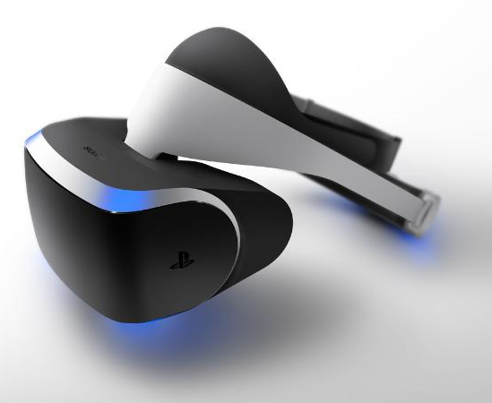
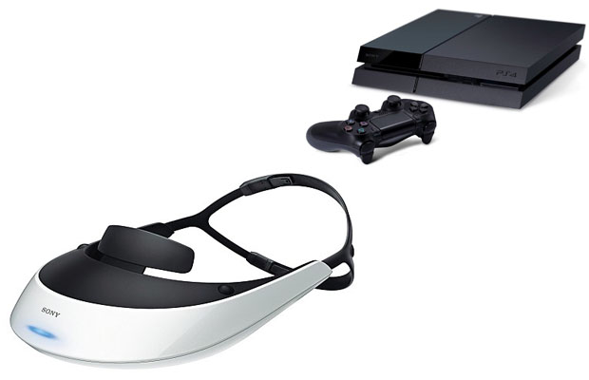
Sony PS4
Notes:
VR Device. In development. Meant to work with PlayStation 4 gaming console. Bundle pack starting at $499. https://www.playstation.com/en-us/explore/playstation-vr/

Slide 15
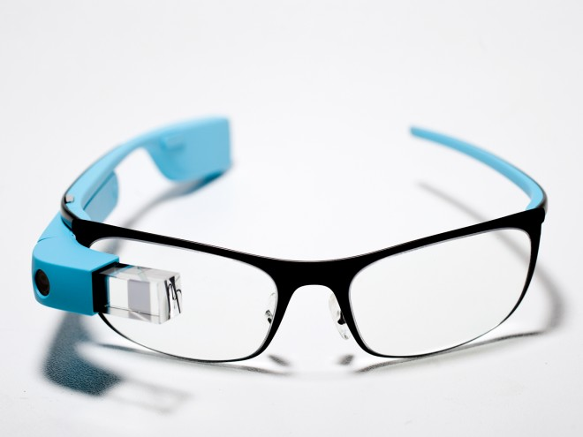
Google Glass
Notes:
discontinued

Slide 16
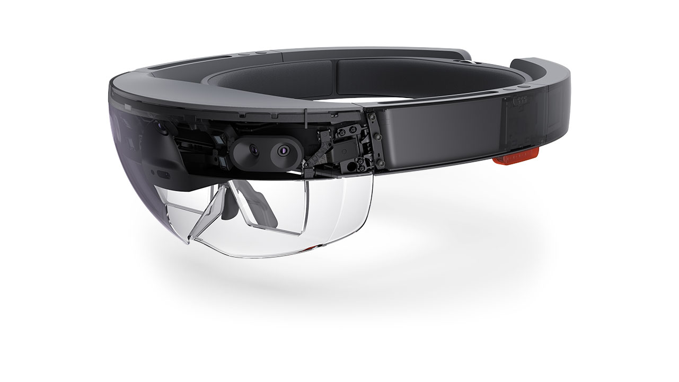
Microsoft Hololens
Notes:
AR device targeting users for gaming, working, connecting. Beyond AR and actually Mixed Reality according to Microsoft. Mixed reality blends 3D holographic content into your physical world, giving your holograms real-world context and scale, allowing you to interact with both digital content and the world around you.

Slide 17
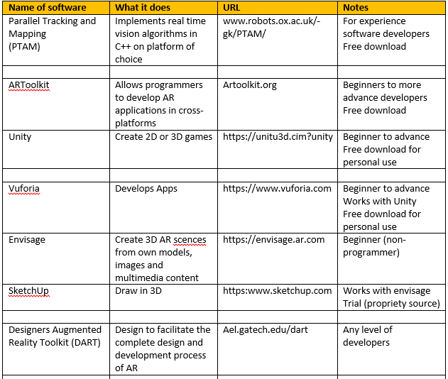
Razvojno okruženje
Unity + Vuforia proširena stvarnost (Augmented reality)

Slide 18
Hvala na pažnji

