Slide 1
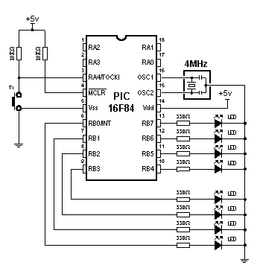
Time delay generation

Slide 2
Time delay generation
PROCESSOR 16F84
#include "p16F84.inc"
__CONFIG _XT_OSC & _CP_OFF & _WDT_OFF & _PWRTE_ON
cblock 0x0C
delayL
delayM
delayH
endc
org 0x00
goto Main
org 0x04
goto Main
Main
clrf PORTB
bsf STATUS, RP0
movlw b'00000000'
movwf TRISB
bcf STATUS, RP0
Loop
bsf PORTB, 3
call Delay500
bcf PORTB, 3
call Delay500
goto Loop
Delay500
clrf delayL
clrf delayM
movlw d'3'
movwf delayH
Label
decfsz delayL
goto Label
decfsz delayM
goto Label
decfsz delayH
goto Label
return
end

Slide 3
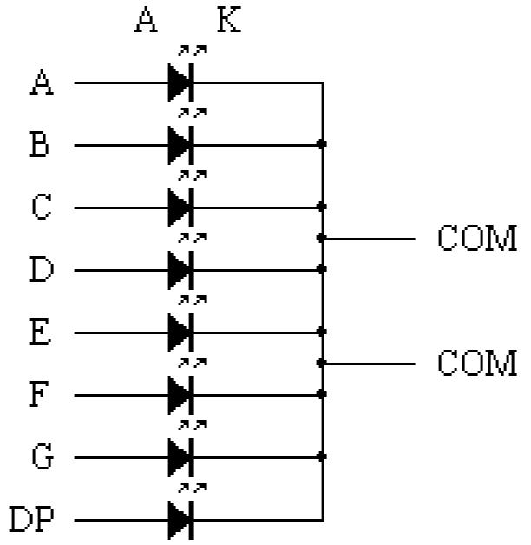
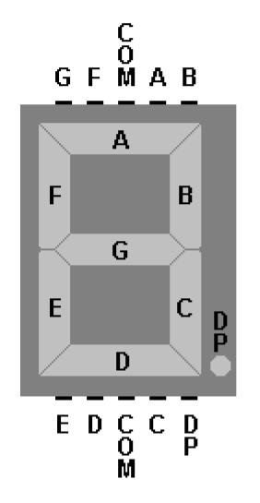
Counting on 7-segment display

Slide 4
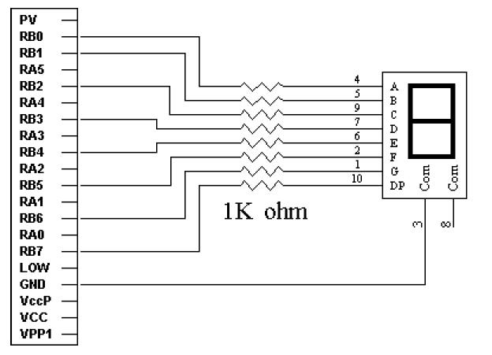
Counting on 7-segment display
PORTB = dp g f e d c b a

Slide 5
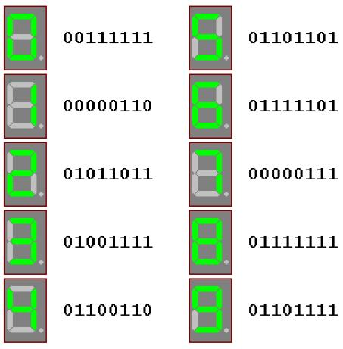
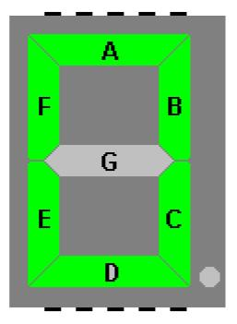
Counting on 7-segment display

Slide 6
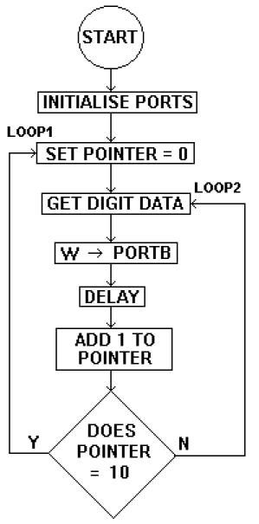
Counting on 7-segment display
PROCESSOR 16F84
#include “p16f84.inc“
__CONFIG _CP_OFF & _WDT_OFF
& _PWRTE_ON & _XT_OSC
cblock
DelayL
DelayM
DelayH
Pointer
endc
org 0h
bsf STATUS,RP0
clrf TRISA
clrf TRISB
bcf STATUS,RP0
Loop1
clrf Pointer
Loop2
movf Pointer,w
call DataTable
movwf PortB
call Delay500
incf Pointer
movlw d'10'
xorwf Pointer,w
btfss Status,Z
goto Loop2
goto Loop1

Slide 7
Counting on 7-segment display
Delay500
clrf DelayL
clrf DelayM
movlw 3h
movwf DelayH
Wait1
decfsz DelayL
goto Wait1
decfsz DelayM
goto Wait1
decfsz DelayH
goto Wait1
return
DataTable
addwf PCL
retlw b'00111111‘ ; 0
retlw b'00000110' ; 1
retlw b'01011011' ; 2
retlw b'01001111' ; 3
retlw b'01100110' ; 4
retlw b'01101101' ; 5
retlw b'01111101' ; 6
retlw b'00000111' ; 7
retlw b'01111111' ; 8
retlw b'01101111' ; 9
end

Slide 8
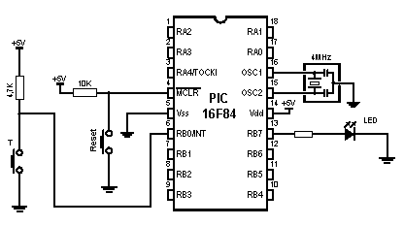
Interrupt on RB0

Slide 9
Interrupt on RB0
PROCESSOR 16F84
#include "p16f84.inc"
__CONFIG _XT_OSC & _PWRTE_ON & _WDT_OFF & _CP_OFF
org 0x00
goto Main
org 0x04
goto ISR
Main
bsf STATUS, RP0
movlw b'00000001'
movwf TRISB
bcf OPTION_REG, INTEDG
bsf OPTION_REG, NOT_RBPU
bcf STATUS, RP0
clrf PORTB
bsf PORTB, 7
bsf INTCON, INTE
bsf INTCON, GIE
Loop
goto Loop
ISR
bcf INTCON, T0IF
btfss PORTB,7
goto Lab1
bcf PORTB,7
retfie
Lab1
bsf PORTB,7
retfie
end

Slide 10
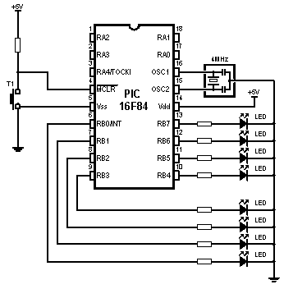
Interrupt on TMR0 overflow
(255-96)*32us = 5.088ms
5.088ms*196 ≈ 1s

Slide 11
Interrupt on TMR0 overflow
PROCESSOR 16F84
#include "p16f84.inc"
__CONFIG _XT_OSC & _PWRTE_ON & _WDT_OFF & _CP_OFF
cblock 0x0C
cnt
endc
org 0x00
goto Main
org 0x04
goto ISR
Main
bsf STATUS,RP0
clrf TRISB
movlw b'10000100'
movwf OPTION_REG
bcf STATUS,RP0
movlw b’00001111’
movwf PORTB
bsf INTCON,T0IE
movlw d'96'
movwf TMR0
bsf INTCON,GIE
clrf cnt
Loop
goto Loop
ISR
movlw d'96'
movwf TMR0
bcf INTCON,T0IF
incf cnt
movlw d'196'
subwf cnt,W
btfss STATUS,Z
retfie
comf PORTB
clrf cnt
retfie
end

