Slide 1
EXAMPLES

Slide 2
Measuring the temperature

Slide 3
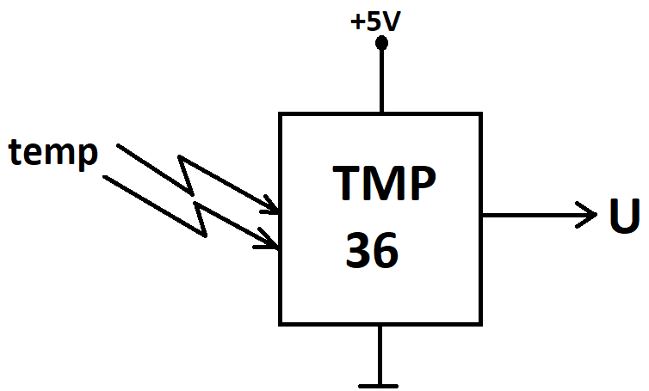

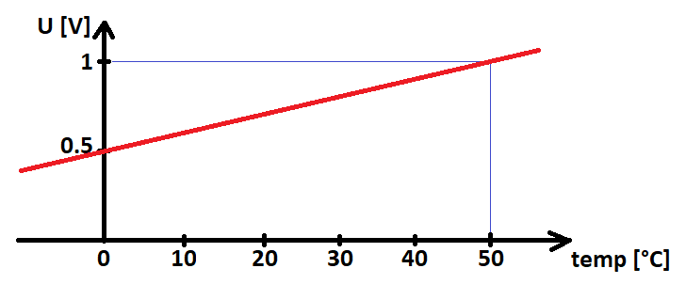
TMP36 temperature sensor
The TMP36 analog sensor produces voltage on its output based on the incoming temperature using the following formula:

Slide 4
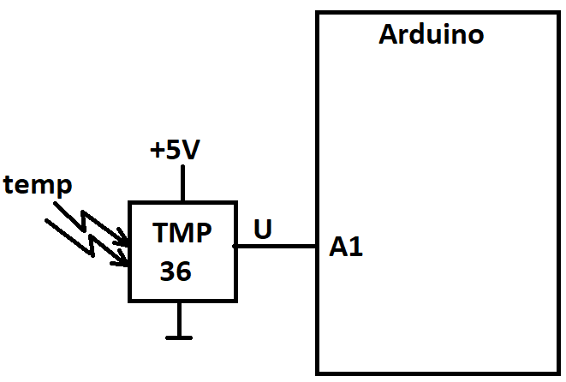
Hardware
The TMP36 analog temperature sensor
is attached to the A1 analog input of the
Arduino.
The analog-to-digital converter converts
the incoming voltage to a value
Between 0 and 1023.

Slide 5
Software
void setup(){
pinMode(A1, INPUT);
Serial.begin(9600);
}
void loop(){
int ADoutValue = analogRead(A1);
Serial.print("A/D output value: ");
Serial.println(ADoutValue);
float voltage = (ADoutValue/1024.0)*5.0;
Serial.print("Voltage: ");
Serial.println(voltage);
float temperature = (voltage-0.5)*100;
Serial.print("Temperature: ");
Serial.println(temperature);
Serial.println("");
delay(500);
}

Slide 6
Comparing two temperatures

Slide 7
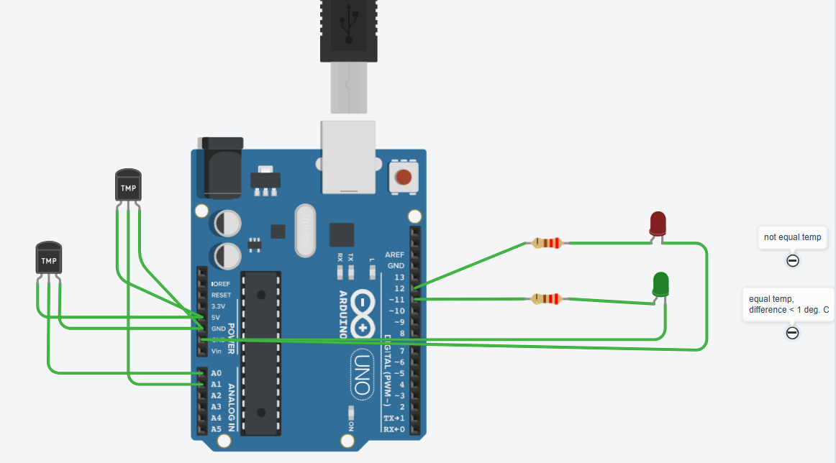
Hardware

Slide 8
Software
float voltageA0 = (sensorValA0 / 1024.0) * 5.0;
Serial.print("Voltage A0: ");
Serial.println(voltageA0);
float temperatureA0 = (voltageA0 - 0.5) * 100;
Serial.print("Temperature A0: ");
Serial.println(temperatureA0);
Serial.println("");
float voltageA1 = (sensorValA1 / 1024.0) * 5.0;
Serial.print("Voltage A1: ");
Serial.println(voltageA1);
float temperatureA1 = (voltageA1 - 0.5) * 100;
Serial.print("Temperature A1: ");
Serial.println(temperatureA1);
Serial.println("");
delay(1000);
const int sensorPinA0 = A0;
const int sensorPinA1 = A1;
const int greenLED = 11;
const int redLED = 12;
void setup()
{
Serial.begin(9600);
}
void loop()
{
int sensorValA0 = analogRead(sensorPinA0);
Serial.print("Sensor value A0: ");
Serial.println(sensorValA0);
int sensorValA1 = analogRead(sensorPinA1);
Serial.print("Sensor value A1: ");
Serial.println(sensorValA1);
if (abs(temperatureA0 - temperatureA1) < 1){
digitalWrite(greenLED, HIGH);
digitalWrite(redLED, LOW);
}
else{
digitalWrite(greenLED, LOW);
digitalWrite(redLED, HIGH);
}
}

Slide 9
Counting on a 7-segment display

Slide 10
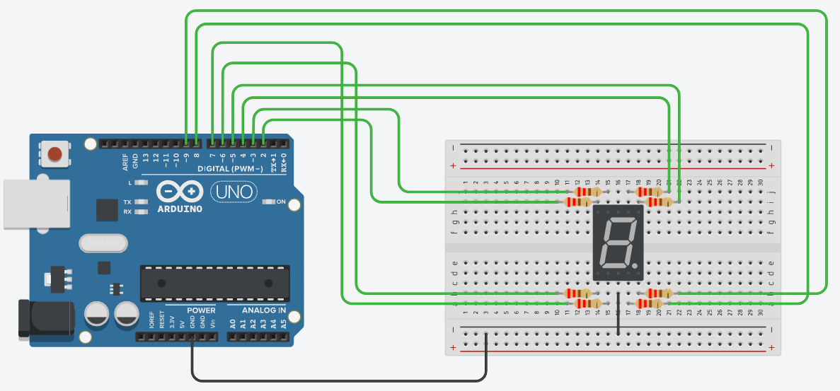
Hardware

Slide 11
Software
void loop() {
// loop for counting from 0 to 9
for (int num = 0; num <=9; num++) {
printNumber(num);
delay(500);
}
}
// function for displaying digits
void printNumber(int number) {
int pin;
for (int j = 0; j < 7; j++) {
pin = seven_seg[j];
digitalWrite(pin, num_array[number][j]);
}
}
// A,B,C,D,E,F,G: array for storing the segments
int seven_seg[] = {4, 5, 8, 7, 6, 3, 2, 9};
int num_array[10][7] = {{ 1, 1, 1, 1, 1, 1, 0 }, // 0
{ 0, 1, 1, 0, 0, 0, 0 }, // 1
{ 1, 1, 0, 1, 1, 0, 1 }, // 2
{ 1, 1, 1, 1, 0, 0, 1 }, // 3
{ 0, 1, 1, 0, 0, 1, 1 }, // 4
{ 1, 0, 1, 1, 0, 1, 1 }, // 5
{ 1, 0, 1, 1, 1, 1, 1 }, // 6
{ 1, 1, 1, 0, 0, 0, 0 }, // 7
{ 1, 1, 1, 1, 1, 1, 1 }, // 8
{ 1, 1, 1, 1, 0, 1, 1 }}; // 9
// function definition
void printNumber(int);
void setup() {
for (int i = 0; i <= 8; i++) {
pinMode(seven_seg[i], OUTPUT);
}
}

Slide 12
Connecting a potentiometer

Slide 13
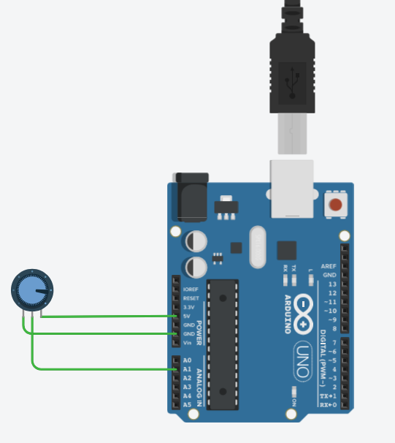
Hardware and software
void setup()
{
pinMode(A1, INPUT);
Serial.begin(9600);
}
void loop()
{
int x = analogRead(A1);
Serial.println(x);
delay(100);
}

Slide 14
LEDs and switches

Slide 15
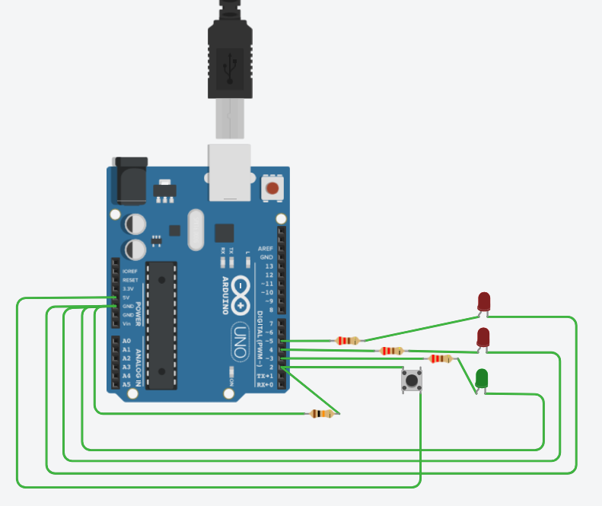
Hardware

Slide 16
Software
// if the button is not pressed
// turn on the green LED and off the red LEDs
if (switchstate == LOW) {
digitalWrite(3, HIGH); // turn the green LED on pin 3 on
digitalWrite(4, LOW); // turn the red LED on pin 4 off
digitalWrite(5, LOW); // turn the red LED on pin 5 off
}
// this else is part of the above if() statement.
// if the switch is not LOW (the button is pressed)
// turn off the green LED and blink alternatively the red LEDs
else {
digitalWrite(3, LOW); // turn the green LED on pin 3 off
digitalWrite(4, LOW); // turn the red LED on pin 4 off
digitalWrite(5, HIGH); // turn the red LED on pin 5 on
// wait for a quarter second before changing the light
delay(250);
digitalWrite(4, HIGH); // turn the red LED on pin 4 on
digitalWrite(5, LOW); // turn the red LED on pin 5 off
// wait for a quarter second before changing the light
delay(250);
}
}
// Create a global variable to hold the
// state of the switch. This variable is persistent
// throughout the program. Whenever you refer to
// switchState, you’re talking about the number it holds
int switchstate = 0;
void setup() {
// declare the LED pins as outputs
pinMode(3, OUTPUT);
pinMode(4, OUTPUT);
pinMode(5, OUTPUT);
// declare the switch pin as an input
pinMode(2, INPUT);
}
void loop() {
// read the value of the switch
// digitalRead() checks to see if there is voltage
// on the pin or not
switchstate = digitalRead(2);

Slide 17
LIGHT DEPENDENT RESISTOR (LDR)

Slide 18
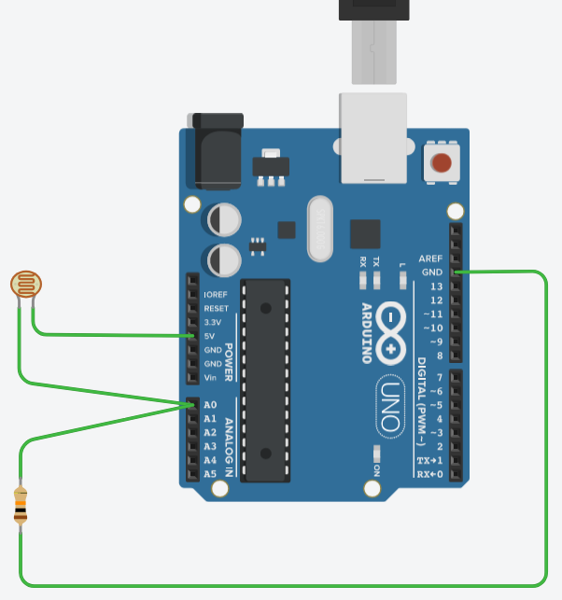
Hardware and software
void setup()
{
pinMode(A0, INPUT);
Serial.begin(9600);
}
void loop()
{
int x = analogRead(A0);
float u = (x * 5.0) / 1023.0;
Serial.print("A/D output value: ");
Serial.println(x);
Serial.print("Voltage on A0: ");
Serial.println(u);
Serial.println("");
delay(500);
}

Slide 19
ADJUST LED FREQUENCY USING POT-METER

Slide 20
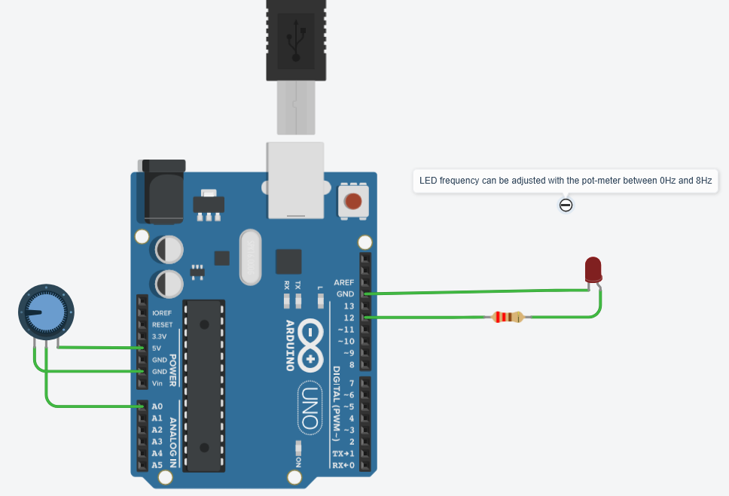
Hardware and software
const int ledPin = 12;
int potA0 = 0;
void setup()
{
pinMode(ledPin, OUTPUT);
Serial.begin(9600);
}
void loop()
{
int valA0 = analogRead(A0);
float freq = int(valA0/128)+1;
Serial.print("Frekvencia: ");
Serial.println(freq);
int tON = round((1/(2*freq))*1000);
Serial.print("tON: ");
Serial.println(tON);
Serial.println("");
digitalWrite(ledPin, HIGH);
delay(tON);
digitalWrite(ledPin, LOW);
delay(tON);
}

