Slide 1
LED intensity change using the PWM module

Slide 2
Problem
Connect the hardware and write the software to change the intensity of the LED using the PWM module.
The LED intensity should be changed from 0% to 100% and back to 0%.
The duration of each state should last 30ms.

Slide 3
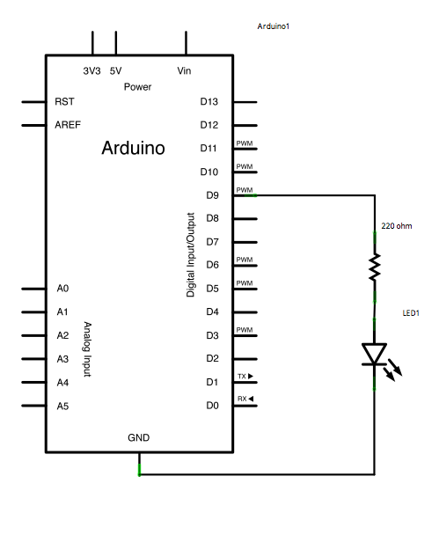
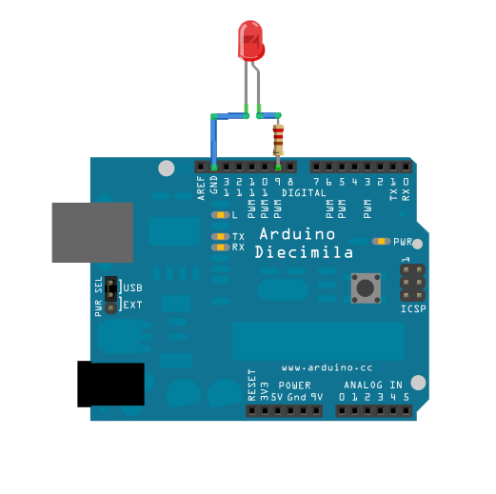
Hardware

Slide 4
Software
int led = 9; // the PWM pin the LED is attached to
int brightness = 0; // how bright the LED is
int fadeAmount = 5; // how many points to fade the LED by
// the setup routine runs once when you apply power or press reset:
void setup() {
// declare pin 9 to be an output:
pinMode(led, OUTPUT);
}

Slide 5
Softver
void loop() {
// set the brightness of pin 9:
analogWrite(led, brightness);
// change the brightness for next time through the loop:
brightness = brightness + fadeAmount;
// reverse the direction of the fading at the ends of the fade:
if (brightness <= 0 || brightness >= 255) {
fadeAmount = -fadeAmount;
}
// wait for 30 milliseconds to see the dimming effect
delay(30);
}

Slide 6
Program code analysis
In this example analogWrite() function is used.
analogWrite() uses the PWM module, care should be taken which pin we use.
Only pins marked with “~” have PMW capabilities.
analogWrite(led, 0) turns on the LED with minimal (zero %) intensity.
analogWrite(led, 255) turns on the LED with maximal (100%) intensity.

Slide 7
Program code analysis
int led = 9; // PWM pin for the LED
int brightness = 0; // LED brightness at the beginning
int fadeAmount = 5; // amount of change in LED brightness at
// each step
// setup will be executed only once after reset or power-on
void setup() {
// declaration of pin 9 as output:
pinMode(led, OUTPUT);
}

Slide 8
Program code analysis
void loop() {
// set initial LED intensity:
analogWrite(led, brightness);
// change the intensity for the next passing through the loop():
brightness = brightness + fadeAmount;
// at the end of the interval change the direction of the intensity change:
if (brightness <= 0 || brightness >= 255) {
fadeAmount = -fadeAmount;
}
// wait 30ms to see the change in intensity
delay(30);
}

Slide 9
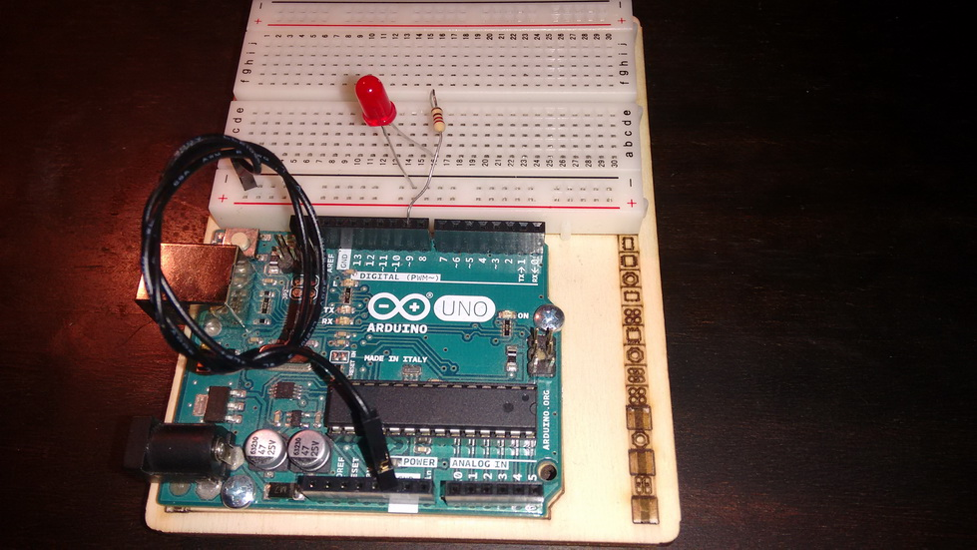
Complete project

Slide 10
Task for self-practice
Change the value of fadeAmount and follow how the functionality changes.
Change the delay between consescutive states (30ms) and follow how functionality changes.
Connect one more LED. Two 2 LEDs have to work in counter-phase. First LED: 0%-100%, second LED: 100%-0%.

