Slide 1
Analog-to-digital converter
A/D converter (ADC)

Slide 2
Analog-to-digital converter
Microcontrollers can handle only digital data (0 and 1).
Most of the real world signals are analog (sensors): temperature, pressure, humidity.
For processing analog signals, the microcontroller first have to convert them into digital signals. That’s where the ADC comes into picture.

Slide 3
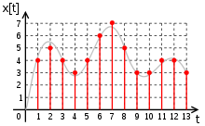
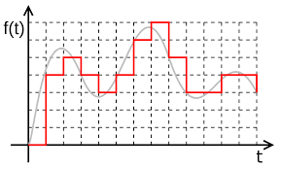
Conversion example
Analog signal is continuous both in time and in amplitude.
By discretization both time and amplitude digital signal is obtained.

Slide 4
Signal reception
In general, signal (data) reception is done in 3 steps:
1. Based on a physical quantity, the sensor provides an analog electrical value on its output.
2. For easy processing, the analog signal is converted into digital using the ADC.
3. The digital signal is transferred to the microcontroller for further processing.

Slide 5
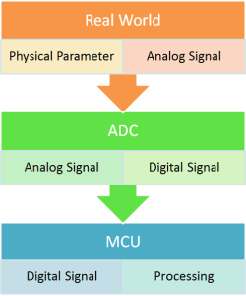
Signal reception and processing

Slide 6
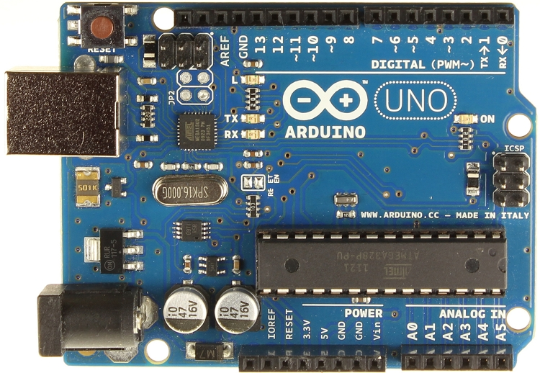
Analog inputs
Modern microcontrollers have built-in analog to digital converters, it is not necessary to use external circuits.

Slide 7
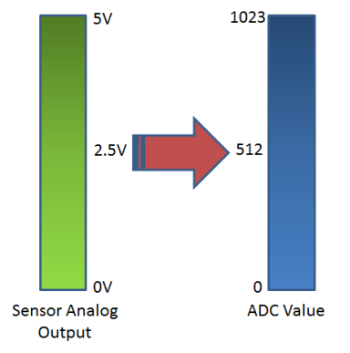
ADC parameters
Principle: successive approximation
6 channels (multiplexed),
10-bit resolution (result in range 0-1023)

Slide 8
Analog-to-digital conversion
Reference voltage 5V, all analog voltages are converted into equivalent digital value.
The input range (0V-5V) is divided into 2¹⁰ = 1024 steps.
0V in the input is converted into 0, 5V on the input is converted into 1023, and 2,5V on the input is converted into 512.

Slide 9
ADC types
Successive approximation
Flash converter (very high speed, lower resolution, many comparators are needed. For 8-bit converter 256 comparators are needed.
Other terminology: ADC pre-scaler, ADC registers.

Slide 10
ADC pre-scaler
The ADC converts the analog signal into a digital signal in periodic time intervals.
This interval is determined by the frequency of the oscillator.
The ADC works on frequencies between 50kHz and 200kHz.
The CPU clock is much higher, so division must be done.
THe ADC frequency is obtained by dividing the CPU frequency with the pre-scaler.

Slide 11
ADC pre-scaler
There are pre-defined division fators: 2, 4, 8, 16, 32, 64 i 128.
For example, pre-scaler 64 means
F_ADC = F_CPU/64
F_CPU = 16MHz,
F_ADC = 16M/64 = 250kHz
How to choose the frequency?

Slide 12
ADC pre-scaler
There is a trade-off between frequency and precision.
Higher frequency will result in lower precision and vice-versa.

Slide 13
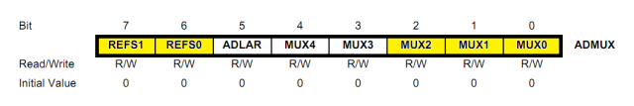
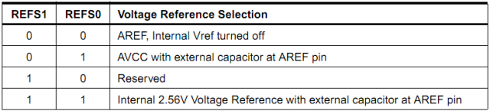
ADC registers
ADMUX – ADC Multiplexer Selection Register
Bits 7-6 : Selection of reference voltage

Slide 14
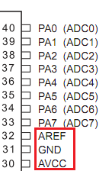
Reference voltage
The ADC needs reference voltage that is determined through AREF, AVCC and GND.
The VCC can vary!

Slide 15
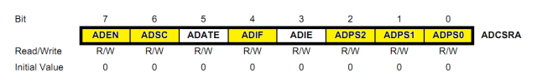
ADC registers
ADLAR – ADC left adjust result
“1”: the result is left-justified
Bits 4-0: Channel selection of the ADC
ADCSRA – ADC Control and Status Register A

Slide 16
ADCSRA
Bit 7 – ADEN – ADC Enable – As the name says, it enables the ADC feature. Unless this is enabled, ADC operations cannot take place across PORTA i.e. PORTA will behave as GPIO pins.
Bit 6 – ADSC – ADC Start Conversion – Write this to ‘1’ before starting any conversion. This 1 is written as long as the conversion is in progress, after which it returns to zero. Normally it takes 13 ADC clock pulses for this operation. But when you call it for the first time, it takes 25 as it performs the initialization together with it.
Bit 5 – ADATE – ADC Auto Trigger Enable – Setting it to ‘1’ enables auto-triggering of ADC. ADC is triggered automatically at every rising edge of clock pulse. View the SFIOR register for more details.

Slide 17
ADCSRA
Bit 4 – ADIF – ADC Interrupt Flag – Whenever a conversion is finished and the registers are updated, this bit is set to ‘1’ automatically. Thus, this is used to check whether the conversion is complete or not.
Bit 3 – ADIE – ADC Interrupt Enable – When this bit is set to ‘1’, the ADC interrupt is enabled. This is used in the case of interrupt-driven ADC.
Bits 2:0 – ADPS2:0 – ADC Prescaler Select Bits – The prescaler (division factor between XTAL frequency and the ADC clock frequency) is determined by selecting the proper combination from the following.

Slide 18
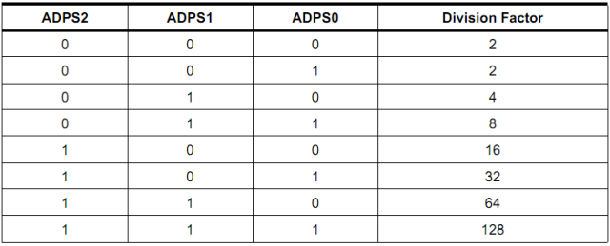
ADC preskaler

Slide 19
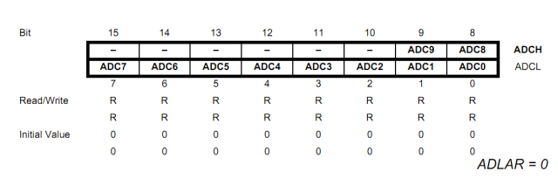
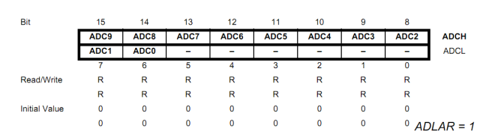
ADCL i ADCH
ADC data registers
qw

Slide 20
ADC init
void adc_init()
{
// AREF = AVcc
ADMUX = (1<<REFS0);
// ADC Enable and prescaler of 128
// 16000000/128 = 125000
ADCSRA = (1<<ADEN)|(1<<ADPS2)|(1<<ADPS1)|(1<<ADPS0);
}

Slide 21
ADC read
uint16_t adc_read(uint8_t ch)
{
// select the corresponding channel 0~7
// ANDing with ’7′ will always keep the value
// of ‘ch’ between 0 and 7
ch &= 0b00000111; // AND operation with 7
ADMUX = (ADMUX & 0xF8)|ch;
// clears the bottom 3 bits before
//ORing
// start single convertion
// write ’1′ to ADSC
ADCSRA |= (1<<ADSC);
// wait for conversion to complete
// ADSC becomes ’0′ again
// till then, run loop continuously
while(ADCSRA & (1<<ADSC));
return (ADC);
}

Slide 22
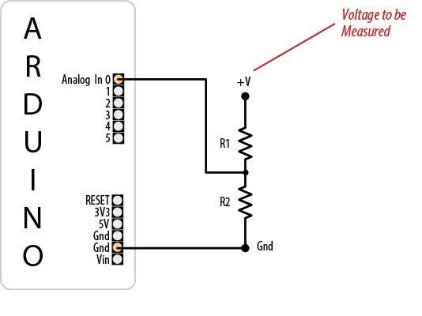
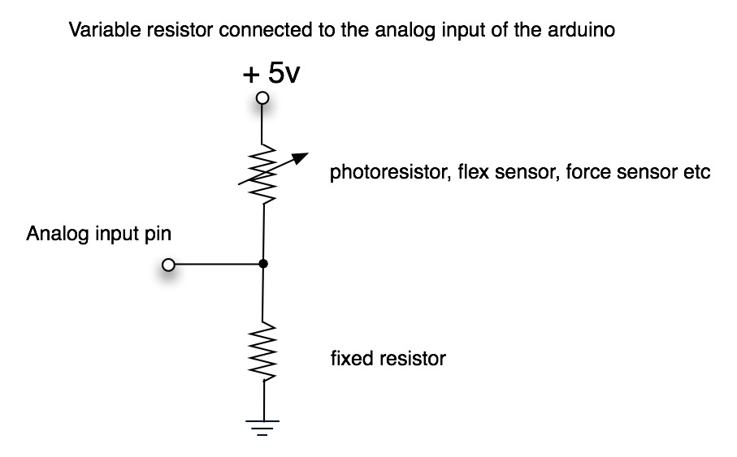
Voltage divider

