Slide 1
MICROCONTROLLERS

Slide 2
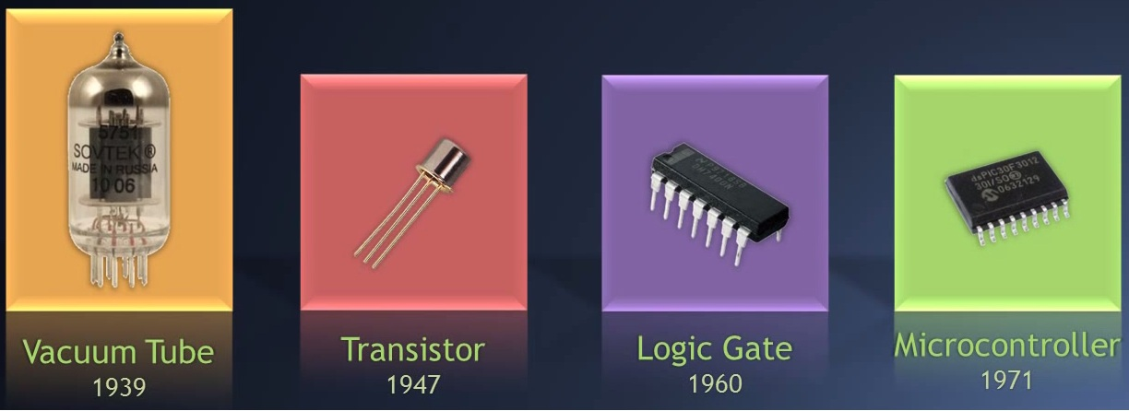
Historical review

Slide 3
Microcontroller
Microcontroller is an integrated circuit that is programmed by the developer for performing specific tasks.
Microcontroller is actually a “mini computer”.

Slide 4
MICROPROCESSOR vs.
MICROCONTROLLER
Microprocessor is used to perform arithmetic and logic operations. It is the most important aprt of personal computers and embedded system applications.
Microprocessors do not have built-in periferials such as RAM, ROM, timers, counters, inputs/outputs, they must be connected separately according to the project.

Slide 5
MICROPROCESSOR vs.
MICROCONTROLLER
Microcontrollers have a fixed amount on on-chip RAM, ROM, input/output ports, timers and counters.
Microcontrollers are useful for cheap applications where speed is not critical.
Microcontrollers have low power consumption.

Slide 6
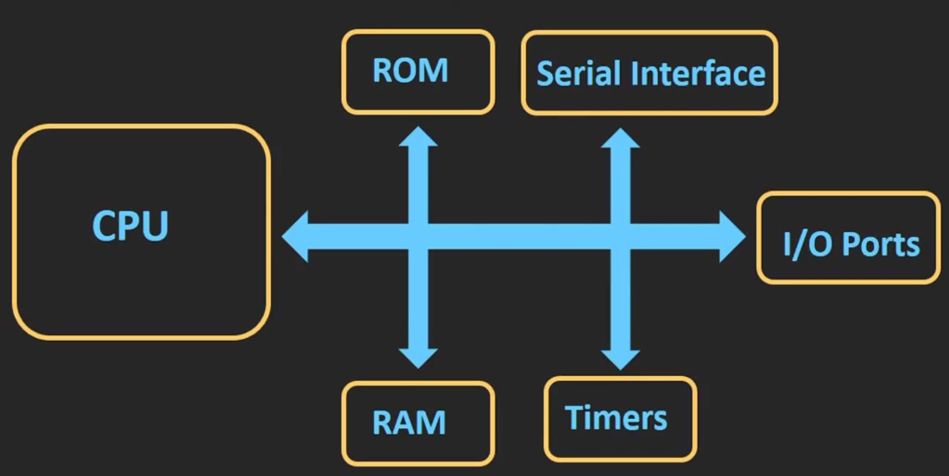
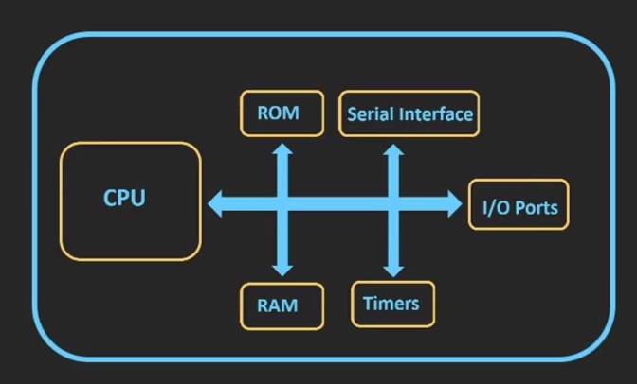
MICROPROCESSOR vs.
MICROCONTROLLER
Microprocessor
Microcontroller

Slide 7
Microprocessor - Application
Microprocessor: Personal computer
Web searching
Video games
Photo and video editing
Creating of documents
Mathematical operations
Simulations
The goal is not defined in advance, high intensity of data processing.

Slide 8
Microcontroller - Application
Used for specific applications.
Digital cameras.
Washing machine
Microwave oven
The goal of these devices is defined in advance.
Microcontroolers are also called goal processors.

Slide 9
Processor speed and memory
Microprocessor
Clock speed: 1GHz – 4GHz
RAM: 1GB – 32GB
ROM (Hard disc): 128GB – 2TB
Peripherals: USB, Ethernet, UART

Slide 10
Processor speed and memory
Microcontroller
Clock speed: 1MHz – 300MHz
RAM: 2kB – 256kB
Flash Memory: 32kB – 2MB
Periferals: I2C, SPI, UART

Slide 11
Data (bus) width
Microprocessor: 32 bit – 64 bit
32 bit: microprocessor can handle a 32-bit data at the same time.
Address bus and data bus is either 32 or 64 bit wide.
Microcontroller: 8 bit – 16 bit – 32 bit
Microprocessor can handle more data in a time unit than a microcontroller.

Slide 12
Power consumption and pricing
Microprocessor
Power consumption: HIGH
Price: HIGH
Microcontroller
Power consumption: LOW
Price: LOW

Slide 13
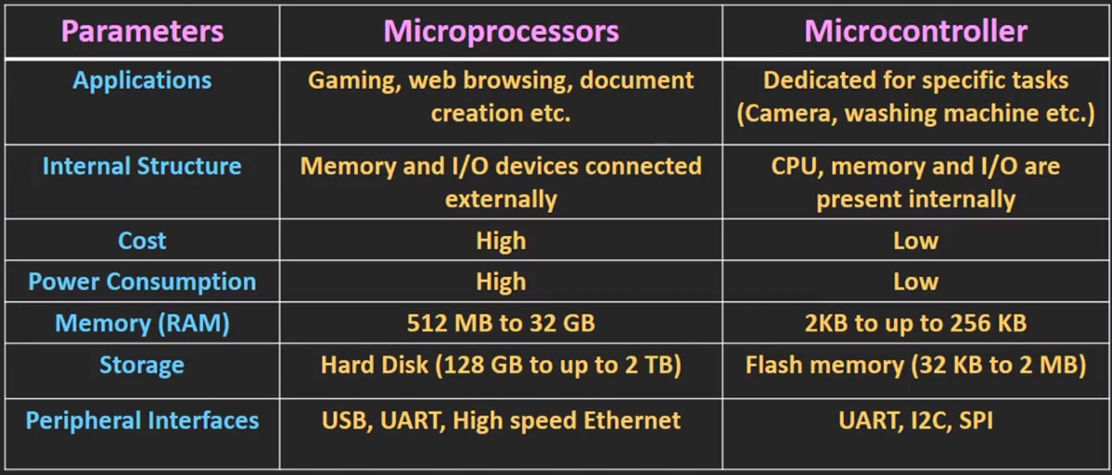
Comparative table

Slide 14
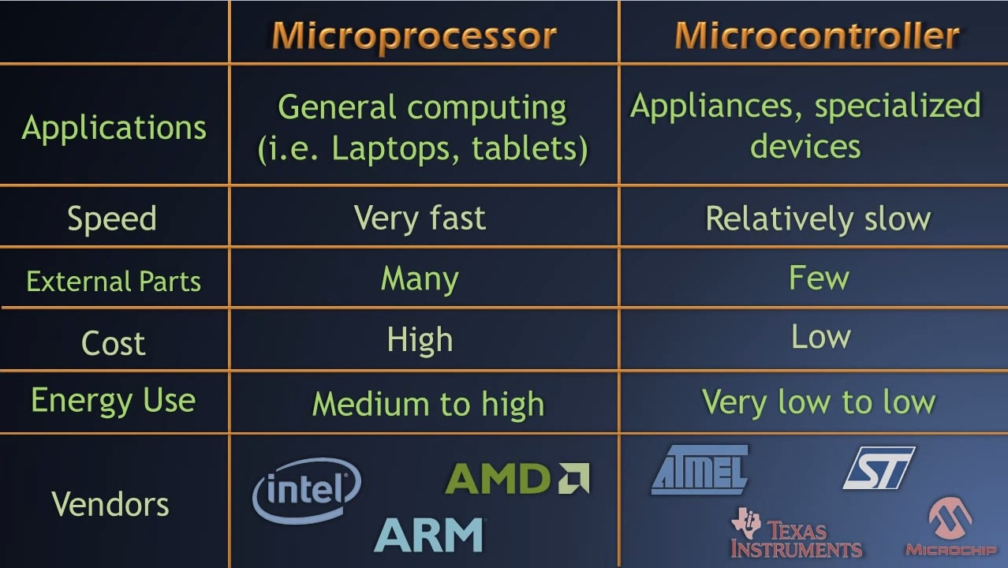
Comparative table

Slide 15
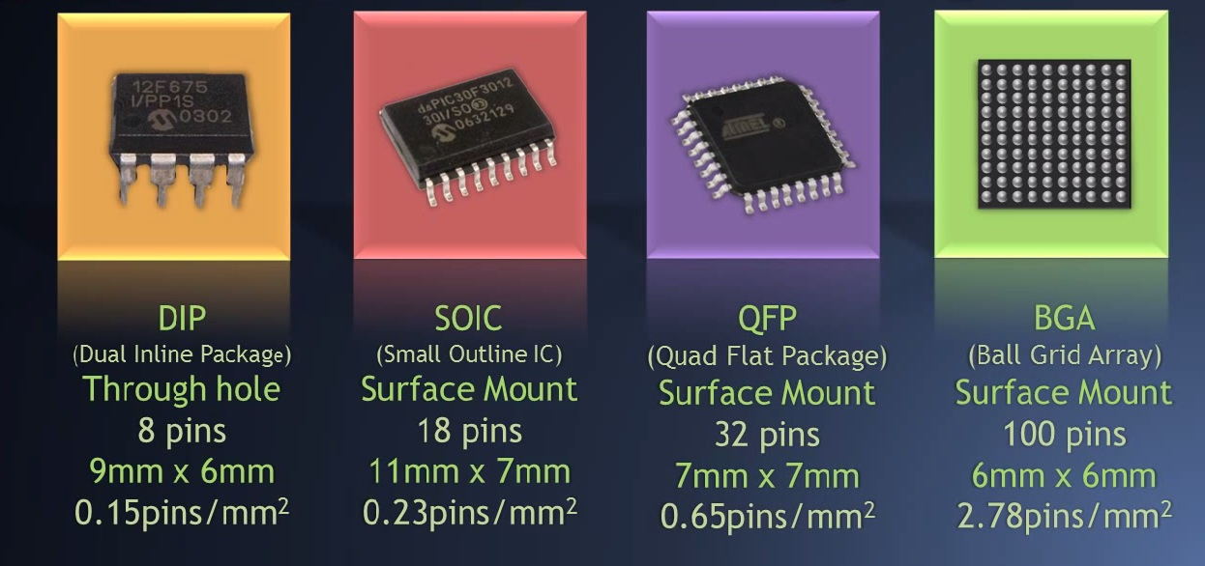
Microcontroller packages

Slide 16
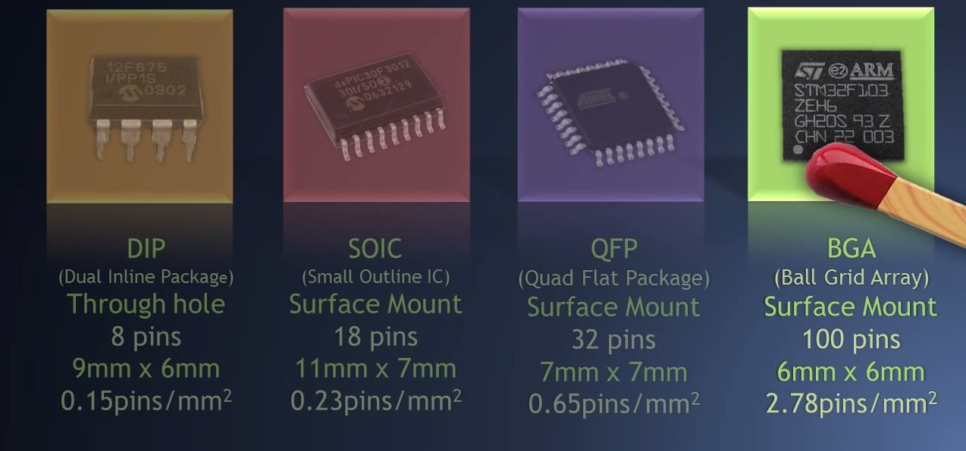
Microcontroller packages

Slide 17
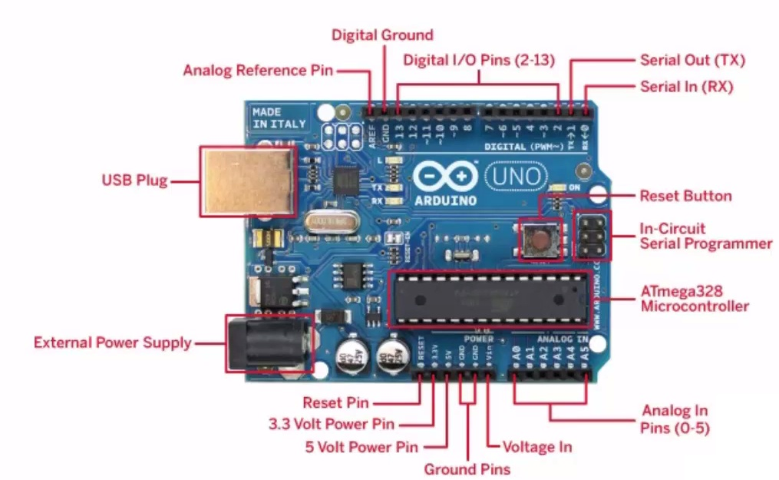
Arduino

Slide 18
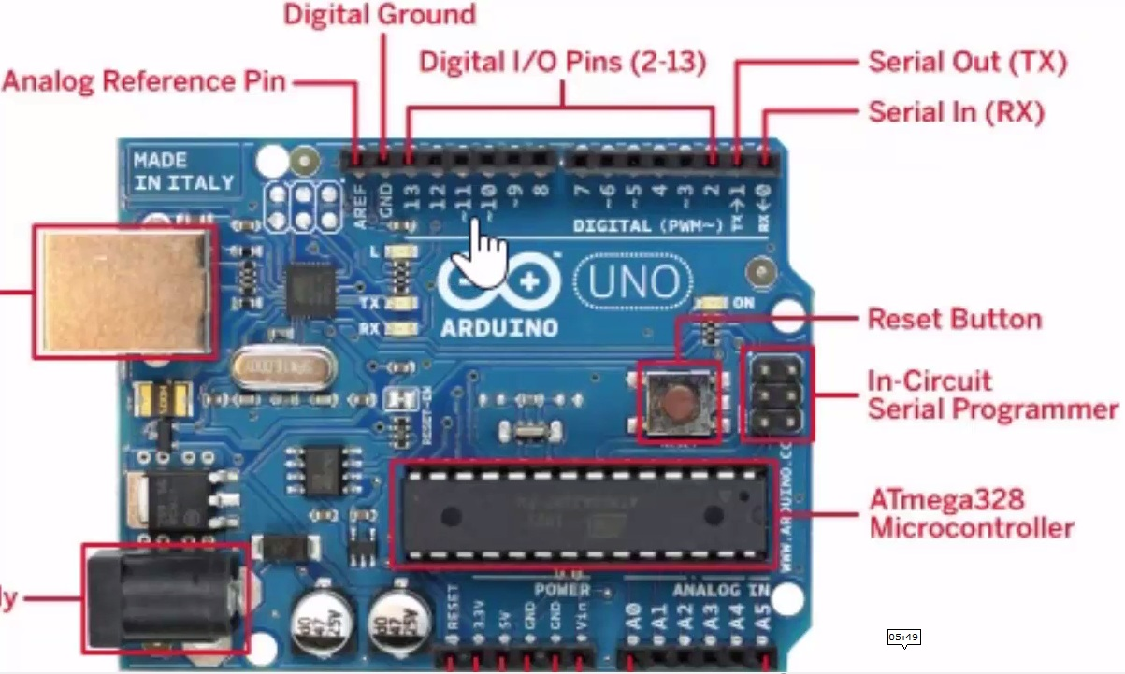
Arduino

