Slide 1
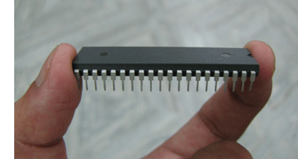
MICROCONTROLLERS
- lectures -
lecturer:
Miklosh Poth
Subotica Tech
Linz, 06-08. May 2025.

Slide 2
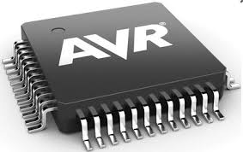
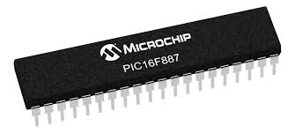
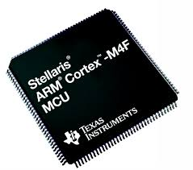
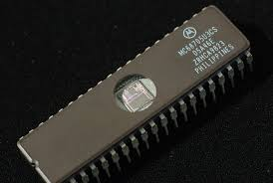
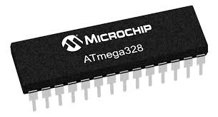
Microcontrollers
Manufacturers: ATMEL, PIC, ARM, MOTOROLA, INTEL, ...

Slide 3
Capabilities of microcontrollers
Microcontrollers are capable of controlling different electronic devices (LED, relay, LCD display, 7-segment display, sensors, communication equipment, …)
Video

Slide 4
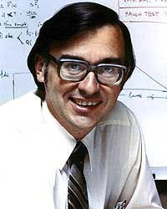
Historical review
1969 – Engineers of Japanese Busicom arrived in USA and addressed Intel to ask for integrated circuits for calculators.
Marcian Hoff represented Intel.
Hoff suggested the program to be stored in the integrated circuit (easier solution, but needed more memory)
Marcian Hoff

Slide 5
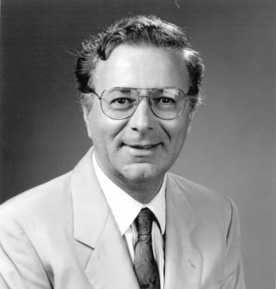
Historical review
Federico Fagin helped Intel and after only 9 month made a complete product.
1971: Intel purchases the licence from Busicom who were not aware what they were selling.
Federico Fagin

Slide 6
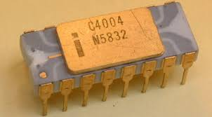
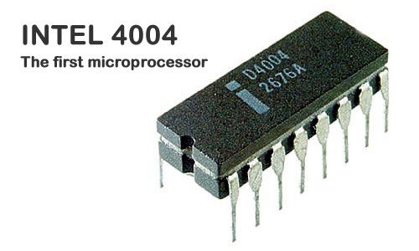
Historical review
1971: First microprocessor 4004.
4-bit architecture with 6000 instructions per second.
Later the American company CTC requested from Intel and Texas Instruments to develop 8-bit microprocessor for terminals (the idea was left).

Slide 7
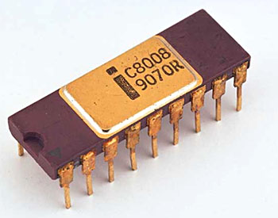
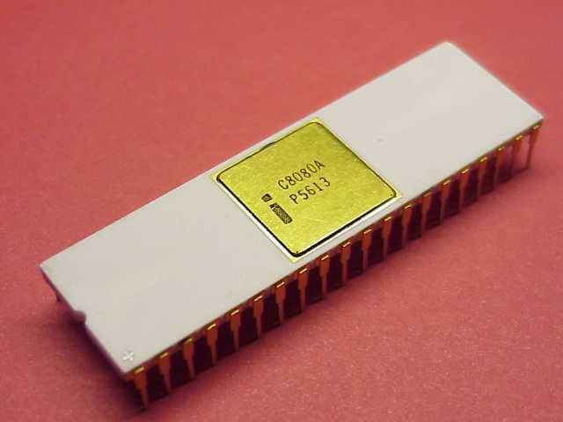
Historical review
Intel and Texas Instruments continued the research and in 1972 they produced the first 8-bit microprocessor 8008.
It could address 16kB of memory, it used 45 instructions and had a speed of 300000 instructions per second.
1974: 8080, it could address 64kB of memory, it had 75 instructions, price: 360$.

Slide 8
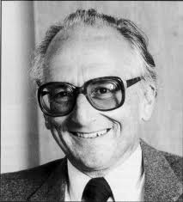
Historical review
In another American company Motorola quickly realized what is happening on the market and they announced the microprocessor 6800.
The constructor was Chuck Peddle.
Peddle left Motorola and switched to MOS technology where he continued his work on microprocessor development.
Chuck Peddle

Slide 9
Historical review
1975, WESCON exhibition: MOS technology announced new prices for 6501 and 6502 for 20$ and 25$.
Intel 8080 and Motorola 6800 then cost 179$. On the first day of the exhibition both prices were reduced to 69.90$.
Motorola accused Peddle that he stole the protected 6800. MOS stays only with 6502.

Slide 10
Historical review
MOS 6502: 8-bit microprocessor with 56 instructions and memory addressing capability of 64kB.
6502 was built into KIM-1, Apple I, Apple II, Atari, Commodore, Acorn, Oric, Galeb, Orao, Ultra, ...
MOS was overtaken by Commodore.
1982: 15 millions sold units!

Slide 11
Historical review
Federico Fagin leaves Intel and starts a new company Zilog Inc. and announces Z80.
He decided the new processor to be compatible with 8080 since there was a lot of programs already written for 8080.
The Z80 was the strongest microprocessor, everybody migrated from 8080 to Z80.
6502, Z80 and 6800 were the best processors.

Slide 12
Microprocessor vs. microcontroller
To use a microcontroller additional componens should be added such as memory and modules for sending and receiving data. The microprocessor is the heart of the computer.
Microcontroller: everything is integrated into a single chip.

Slide 13
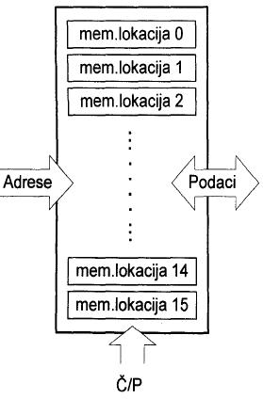
Main parts of the microcontroller
- memory -
The goal of the memory is to store data.
For certain input we get the wanted output.
The Read/Write (R/W- Č/P) line determines if read or write operation will be executed.

Slide 14
Main parts of the microcontroller
- memory -
Addressing
Memory locations
Memory is the set of all memory locations, addressing is selecting one of them.

Slide 15
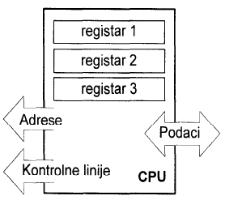
Main parts of the microcontroller
- central processing unit (CPU) -
The memory locations of the CPU are registers.
On registers we can perform arithmetic or logic operations and transfers between them.

Slide 16
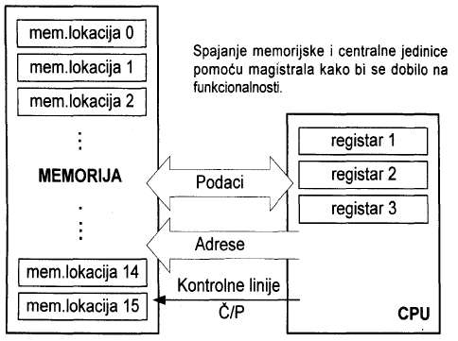
Main parts of the microcontroller
- bus -
The bus is the connection between the CPU and memory. It is a set of 8 or 16 paralell wires. wires.
The address bus
determines how much
memory can be
addressed.
The data bus is the
same width as the data.
Still no connection with the outer world!

Slide 17
Main parts of the microcontroller
- input/output unit -
Next we add a block with a few memory locations whose one end is connected to the data bus, and the other to the microcontroller output (pins).
The added locations are called ports.
Each port pin can be input, output or bi-directional pin.

Slide 18
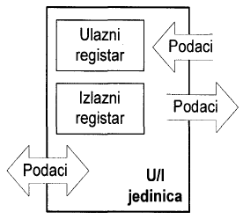
Main parts of the microcontroller
- input/output unit -
The port behaves as a regular memory location.
Its easily read and written.
The operations can be detected on pins.
Communication with the outer world is enabled.

Slide 19
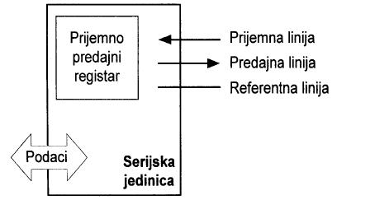
Main parts of the microcontroller
- serial communication -
Disadvantage: data transfer to big distances,
number of lines x number of kilometres !!!
Work with only 3 lines (receive, send, reference line)
Communication rules must be known: protocol

Slide 20
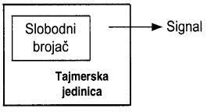
Main parts of the microcontroller
- timer module -
The timer gives information about time.
The basic element of the timer is a free running counter (register) whose value increases in regular time intervals.
The timer connects the number of executed instructions with a physical quantity (time).

Slide 21
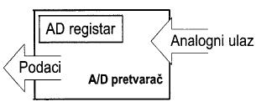
Main parts of the microcontroller
- analog-to-digital converter -
Most natural signals are analog, but the microcontroller understands only 0-s and 1-s, so incoming signals have to be transformed to digital form.
Tha A/D block converts the analog value to binary number and transfers it to the CPU.

Slide 22
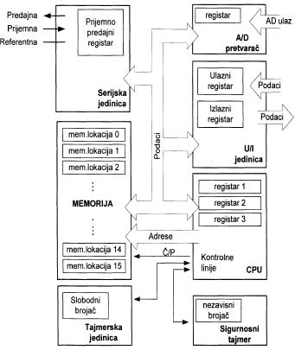
Block diagram of the microcontroller

Slide 23
External parts
Power supply
Crystal oscillator (the heart of the microcontroller). The microcontroller executes the commands based on the impulses of the oscillator.

Slide 24
Architecture
Harvard architecture (not von-Neumann)
Different width for data memory and instructions
Higher speed because of pipelining
Reduced number of instructions (RISC)

Slide 25
Harvard architecture
Program memory and data memory are stored separately (together in von-Neumann architecture).

