Slide 1
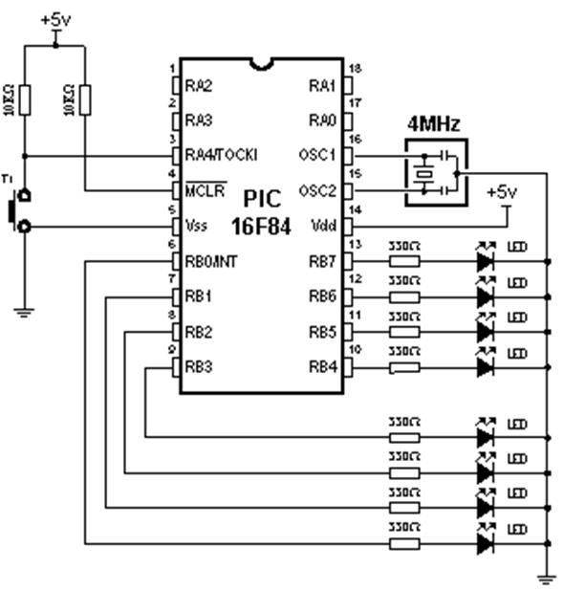
TMR0 bez korišćenja prekida
PROCESSOR 16F84
#include "p16f84.inc"
__CONFIG _XT_OSC & _PWRTE_ON & _WDT_OFF & _CP_OFF
cblock 0x0c
cnt
endc
org 0x00
goto main
org 0x04
goto main

Slide 2
TMR0 bez korišćenja prekida
main
bsf STATUS, RP0
clrf TRISB
movlw b'10000100‘
movwf OPTION_REG
bcf STATUS, RP0
clrf PORTB
movlw d‘96‘
movwf TMR0
clrf cnt
Loop
movlw d’0’
subwf TMR0, W
btfss STATUS, Z
goto Loop
goto Labela
Labela
movlw d'96‘
movwf TMR0
bcf INTCON, T0IF
incf cnt
movlw d'196‘
subwf cnt, W
btfss STATUS, Z
goto Loop
comf PORTB
clrf cnt
goto Loop
end

Slide 3
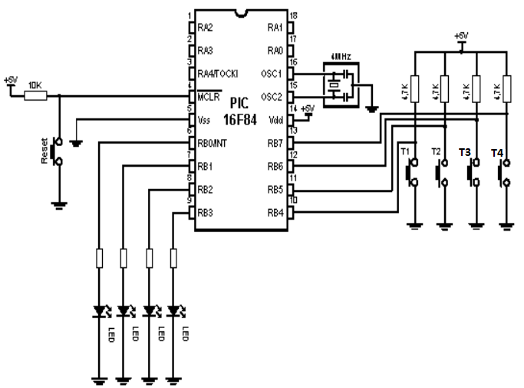
Prekid na RB4-RB7

Slide 4
Prekid na RB4-RB7
PROCESSOR 16f84
#include "p16f84.inc“
__CONFIG _CP_OFF & _WDT_OFF
& _PWRTE_ON & _XT_OSC
org 0x00
goto Main
org 0x04
goto ISR
Main
bsf STATUS, RP0
movlw b'11110000‘
movwf TRISB
bcf STATUS, RP0
movlw b'11111111‘
movwf PORTB
bsf INTCON, RBIE
bsf INTCON, GIE
Loop
goto Loop
ISR
bcf INTCON, RBIF
btfss PORTB, 7
goto Led0
btfss PORTB, 6
goto Led1
btfss PORTB, 5
goto Led2
btfss PORTB, 4
goto Led3
Led0
bcf PORTB, 0
retfie
Led1
bcf PORTB, 1
retfie
Led2
bcf PORTB, 2
retfie
Led3
bcf PORTB, 3
retfie
end

Slide 5
Pomeranje udesno, ulevo (rrf, rlf)
rrf – rotate left file
rlf – rotate right file
Sintaksa:
rrf PORTB
rrf PORTB, f
rrf PORTB, W
f, W - destination (ciljni registar)

Slide 6
Ispitni zadatak (jun 2019)
Na slici je prikazano kolo sa mikrokontrolerom PIC16F84, pri čemu su na PORTB priključene svetleće diode.
a/ Koje će diode svetleti na početku izvršavanja programa? (3 poena)
b/ Koje će sve vrednosti imati promenljiva counter u toku izvršavanja programa?
(6 poena)
c/ Da li postoji neka dioda koja uopšte neće svetleti u toku izvršavanja programa? Ako ima, koja? (6 poena)
d/ Koliko je kašnjenje između pojedinih stanja?

Slide 7
Ispitni zadatak (jun 2019)
PROCESSOR 16F84
#include “p16f84.inc“
__CONFIG _CP_OFF
& _WDT_OFF
& _PWRTE_ON & _XT_OSC
cblock 0x0c
DelayL
DelayH
counter
endc
org 0x00
goto Main
org 0x04
goto Main
bsf STATUS, RP0
clrf TRISB
bcf STATUS, RP0
bcf STATUS, C
movlw b’11110000’
movwf PORTB
clrf counter
Loop1
call Delay
rlf PORTB
incf counter
movlw d’3’
xorwf counter,W
btfss STATUS,Z
goto Loop1
Ciklus
goto Ciklus
Delay
clrf delayL
movlw ’200’
movwf delayH
Wait1
decfsz delayL
goto Wait1
decfsz delayH
goto Wait1
return
end

Slide 9
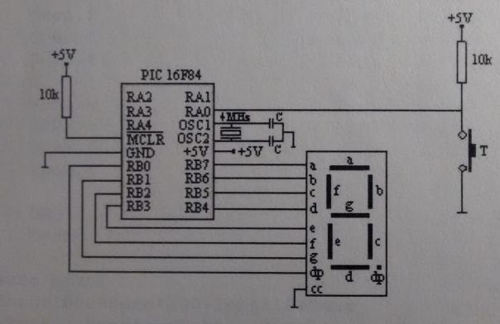
Generisanje slučajnog broja

Slide 11
Generisanje slučajnog broja
PROCESSOR 16f84
#include "p16f84.inc"
__CONFIG _XT_OSC & _WDT_OFF
& _PWRTE_ON & _CP_OFF
cblock 0x0c
rnd
endc
org 0x00
goto Main
org 0x04
goto Main
Main
bsf STATUS, RP0
clrf TRISB
movlw b'00000001‘
movwf TRISA
bcf STATUS, RP0
clrf PORTA
clrf PORTB
clrf rnd
DataTable
addwf PCL
retlw b'00111111' ; 0
retlw b'00000110' ; 1
retlw b'01011011' ; 2
retlw b'01001111' ; 3
retlw b'01100110' ; 4
retlw b'00101101' ; 5
retlw b'00111101' ; 6
retlw b'00000111' ; 7
retlw b'01111111' ; 8
retlw b'01101111' ; 9
retlw b'01110111' ; A
retlw b'01111100' ; b
retlw b'00111001' ; C
retlw b'01011110' ; d
retlw b'01111001' ; E
retlw b'01110001' ; F
return
end
ciklus
incf rnd
btfsc PORTA, 0
goto ciklus
clrc
rrf rnd
rrf rnd
rrf rnd
rrf rnd
movlw b'00001111‘
andwf rnd, W
call DataTable
movwf PORTB
goto ciklus

Slide 12
Generisanje slučajnog broja
ciklus
incf rnd
btfsc PORTA, 0
goto ciklus
clrc
rrf rnd
rrf rnd
rrf rnd
rrf rnd
movlw b'00001111‘
andwf rnd, W
call DataTable
movwf PORTB
goto ciklus
DataTable
addwf PCL
retlw b'00111111' ; 0
retlw b'00000110' ; 1
retlw b'01011011' ; 2
retlw b'01001111' ; 3
retlw b'01100110' ; 4
retlw b'00101101' ; 5
retlw b'00111101' ; 6
retlw b'00000111' ; 7
retlw b'01111111' ; 8
retlw b'01101111' ; 9
retlw b'01110111' ; A
retlw b'01111100' ; b
retlw b'00111001' ; C
retlw b'01011110' ; d
retlw b'01111001' ; E
retlw b'01110001' ; F
return
end

Slide 13
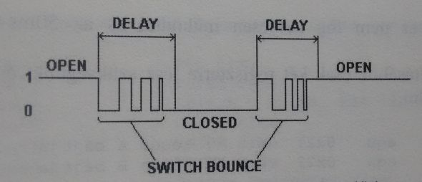
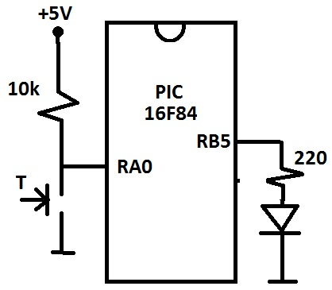
Debounce
Pritisak tastera:

Slide 14
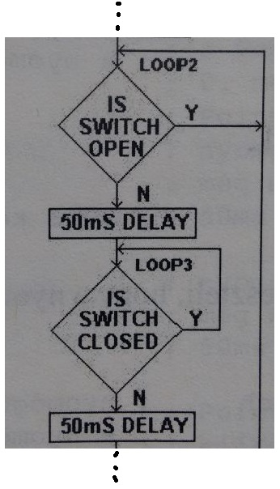
Debounce
Loop2
btfsc PORTA, 0
goto Loop2
call delay50
Loop3
btfss PORTA, 0
goto Loop3
call delay50

