Slide 1
Analiza programskog kod-a
List file (.lst)
Hex file (.HEX)

Slide 2
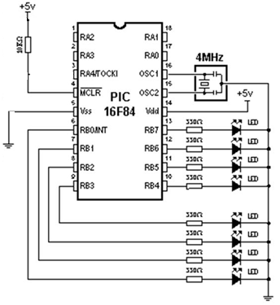
Hardver
RB0, RB1, RB2, RB3 – ON
RB4, RB5, RB6, RB7 – OFF

Slide 3
.asm file
errorlevel -205
PROCESSOR 16f84
#include "p16f84.inc"
__CONFIG _XT_OSC & _PWRTE_ON &
_WDT_OFF & _CP_OFF
errorlevel -203
errorlevel -302
org 0x00
goto Main
org 0x04
goto Main
Main
bsf STATUS, RP0
clrf TRISA
clrf TRISB
bcf STATUS, RP0
movlw b'00001111‘
movwf PORTB
Loop
goto Loop
end

Slide 4
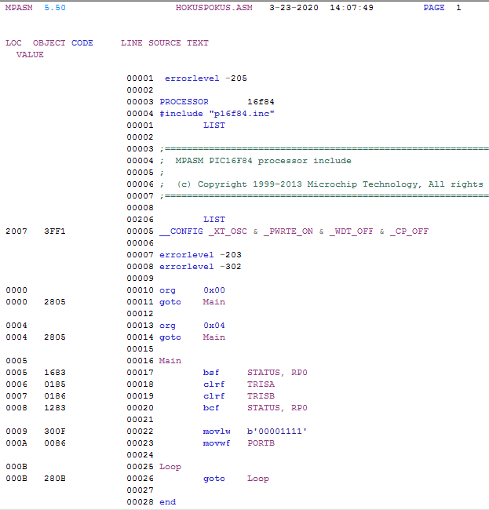
.lst file

Slide 5
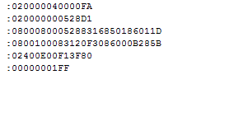
.hex file

Slide 6
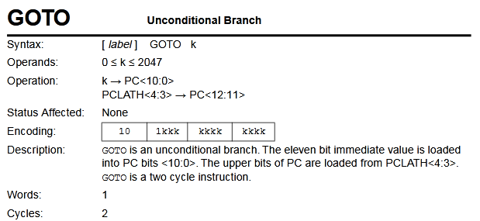
Instrukcije

Slide 7
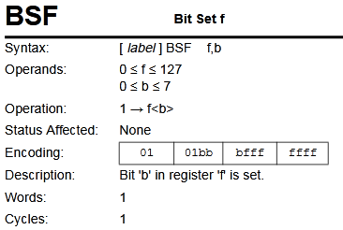
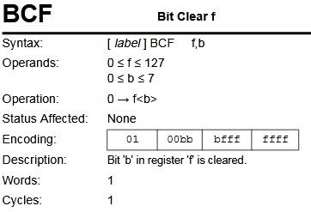
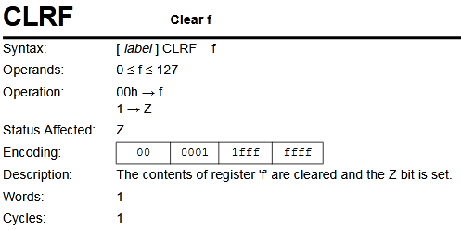
Instrukcije

Slide 8
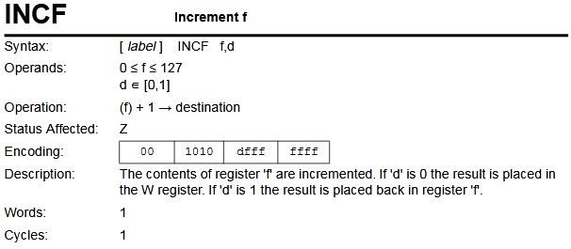
Instrukcije

Slide 9
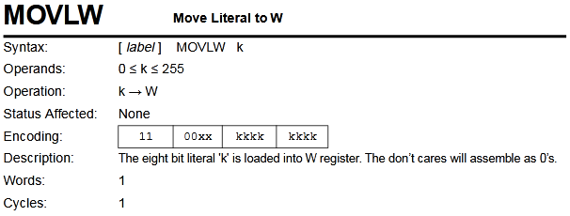
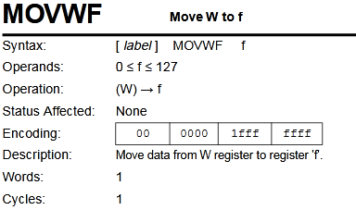
Instrukcije

Slide 10
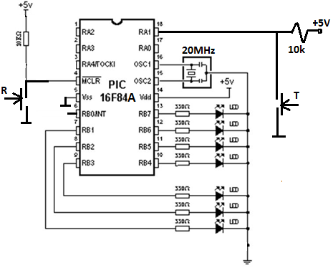
Kocka za bacanje
https://people.vts.su.ac.rs/~pmiki/_DALJINSKA_NASTAVA_ASEMBLERI/11.05/PIC_Dice.mp4

Slide 11
Kocka za bacanje
Loop
clrf Pointer
btfsc PORTA, 1
goto Loop
call Delay10ms
btfsc PORTA, 1
goto Loop
call Shuffle
goto Loop
Shuffle
movf Pointer, 0
call Table
movwf PORTB
call Delay20ms
btfss PORTA, 1
goto $+5
call Delay10ms
btfss PORTA, 1
goto $+2
return
incf Pointer, 1
movf Pointer, W
sublw 6
btfss STATUS, Z
goto Shuffle
clrf Pointer
goto Shuffle
PROCESSOR 16f84
#include "p16f84.inc"
__CONFIG _XT_OSC & _WDT_OFF &
_PWRTE_ON & _CP_OFF
cblock 0x0c
Pointer
d1
d2
d3
endc
org 0x00
goto Main
org 0x04
goto Main
Main
bsf STATUS, RP0
clrf TRISB
clrf TRISA
bsf TRISA, 1
bcf STATUS, RP0
movlw b'11111110‘
movwf PORTB
Table
addwf PCL
retlw 0x10
retlw 0x82
retlw 0x92
retlw 0xAA
retlw 0xBA
retlw 0xEE
Delay10ms
…
Delay20ms
…
end

Slide 12
Kocka za bacanje
Delay10ms
movlw d'6‘
movwf d3
movlw d'11‘
movwf d2
movlw d'255‘
movwf d1
decfsz d1
goto $-1
decfsz d2
goto $-5
decfsz d3
goto $-9
return
Delay20ms
movlw d'5‘
movwf d3
movlw d'27‘
movwf d2
movlw d'255‘
movwf d1
decfsz d1
goto $-1
decfsz d2
goto $-5
decfsz d3
goto $-9
return
end

Slide 13
Kocka za bacanje
Shuffle
movf Pointer, 0
call Table
movwf PORTB
call Delay20ms
btfss PORTA, 1
goto $+5
call Delay10ms
btfss PORTA, 1
goto $+2
return
incf Pointer, 1
movf Pointer, W
sublw 6
btfss STATUS, Z
goto Shuffle
clrf Pointer
goto Shuffle
Table
addwf PCL
retlw 0x10
retlw 0x82
retlw 0x92
retlw 0xAA
retlw 0xBA
retlw 0xEE
Delay10ms
return
Delay20ms
return
end

Slide 15
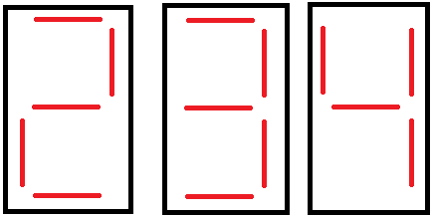
Izdvajanje cifara
d’234’ = b’11101010’
Stotine=2
(var_100)
Desetice=3
(var_10)
Jedinice=4
(var_1)

Slide 16
Izdvajanje cifara (getnums.asm)
PROCESSOR 16f84
#include "p16f84.inc"
__CONFIG _XT_OSC & _WDT_OFF &
_PWRTE_ON & _CP_OFF
#include "bank.inc"
#include "digit.inc"
cblock 0x0c
var_100
var_10
var_1
rez
temp
endc
org 0x00
goto main
org 0x04
goto main
Main
bank1
clrf TRISB
movlw b'00000001‘
movwf TRISA
bank0
clrf PORTB
movlw d'234'
movwf rez
digit rez
Loop
goto Loop
end

Slide 17
Makro za izdvajanje cifara (digit.inc)
digit macro rez
local Loop100
local Loop10
clrf var_100
clrf var_10
clrf var_1
movf rez, W
movwf temp
movlw d'100‘
Loop100
incf var_100, f
subwf temp, f
btfsc STATUS, C
goto Loop100
decf var_100, f
addwf temp, f
movlw d'10'
Loop10
incf var_10, f
subwf temp, f
btfsc STATUS, C
goto Loop10
decf var_10, f
addwf temp, f
movf temp, W
movwf var_1
endm

Slide 18
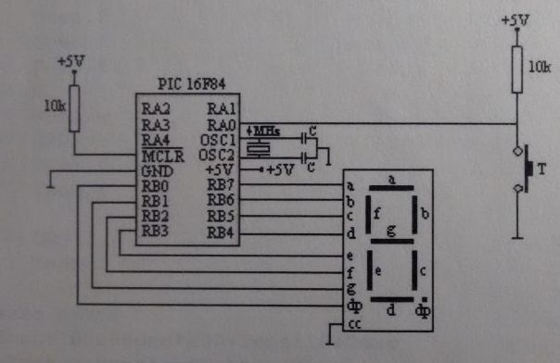
Generisanje slučajnog broja

Slide 20
Generisanje slučajnog broja
PROCESSOR 16f84
#include "p16f84.inc"
__CONFIG _XT_OSC & _WDT_OFF
& _PWRTE_ON & _CP_OFF
cblock 0x0c
rnd
endc
org 0x00
goto Main
org 0x04
goto Main
Main
bsf STATUS, RP0
clrf TRISB
movlw b'00000001‘
movwf TRISA
bcf STATUS, RP0
clrf PORTA
clrf PORTB
clrf rnd
DataTable
addwf PCL
retlw b'00111111' ; 0
retlw b'00000110' ; 1
retlw b'01011011' ; 2
retlw b'01001111' ; 3
retlw b'01100110' ; 4
retlw b'00101101' ; 5
retlw b'00111101' ; 6
retlw b'00000111' ; 7
retlw b'01111111' ; 8
retlw b'01101111' ; 9
retlw b'01110111' ; A
retlw b'01111100' ; b
retlw b'00111001' ; C
retlw b'01011110' ; d
retlw b'01111001' ; E
retlw b'01110001' ; F
return
end
ciklus
incf rnd
btfsc PORTA, 0
goto ciklus
clrc
rrf rnd
rrf rnd
rrf rnd
rrf rnd
movlw b'00001111‘
andwf rnd, W
call DataTable
movwf PORTB
goto ciklus

Slide 21
Generisanje slučajnog broja
ciklus
incf rnd
btfsc PORTA, 0
goto ciklus
clrc
rrf rnd
rrf rnd
rrf rnd
rrf rnd
movlw b'00001111‘
andwf rnd, W
call DataTable
movwf PORTB
goto ciklus
DataTable
addwf PCL
retlw b'00111111' ; 0
retlw b'00000110' ; 1
retlw b'01011011' ; 2
retlw b'01001111' ; 3
retlw b'01100110' ; 4
retlw b'00101101' ; 5
retlw b'00111101' ; 6
retlw b'00000111' ; 7
retlw b'01111111' ; 8
retlw b'01101111' ; 9
retlw b'01110111' ; A
retlw b'01111100' ; b
retlw b'00111001' ; C
retlw b'01011110' ; d
retlw b'01111001' ; E
retlw b'01110001' ; F
return
end

