Slide 1
PREKIDI
(INTERAPTI)

Slide 2
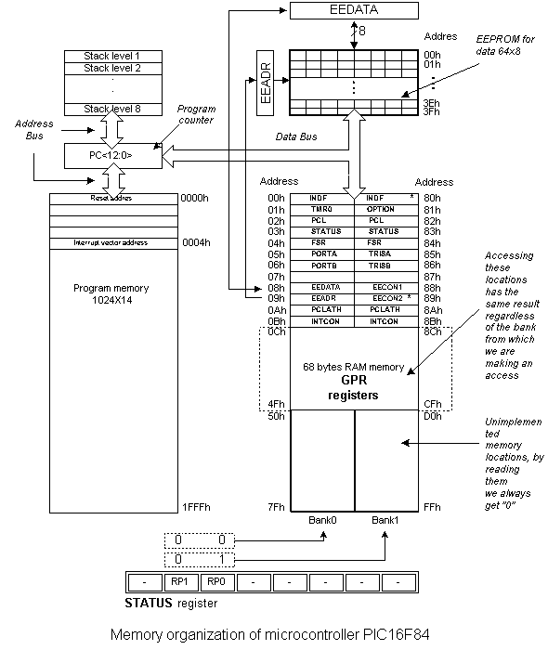
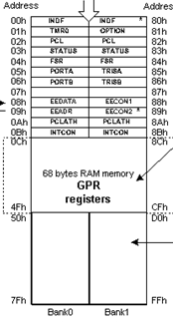
Memorijska organizacija

Slide 3
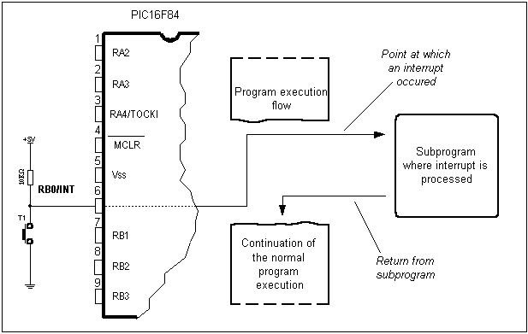
Prekidi
Loop
bsf PORTB, 7
call Delay500
bcf PORTB, 7
call Delay500
goto Loop
Delay500
clrf delayL
clrf delayM
movlw d'3'
movwf delayH
Label
decfsz delayL
goto Label
decfsz delayM
goto Label
decfsz delayH
goto Label
return
end

Slide 4
Izvori prekida
Promena logičkog stanja na nožici RB0
Prekoračenje slobodnog brojača TMR0
Završetak ciklusa upisa u EEPROM
Promena na jednoj od nožica RB4-RB7

Slide 5
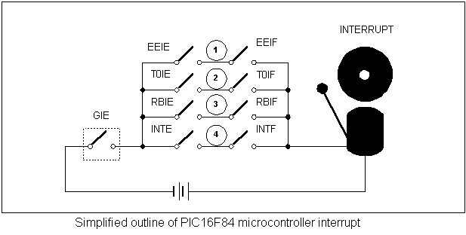
Prekidi – način rada

Slide 6
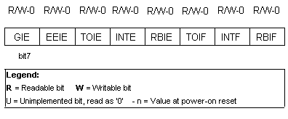
Prekidi – INTCON registar

Slide 7
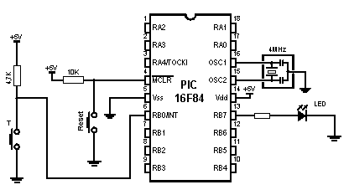
Prekid na RB0

Slide 8
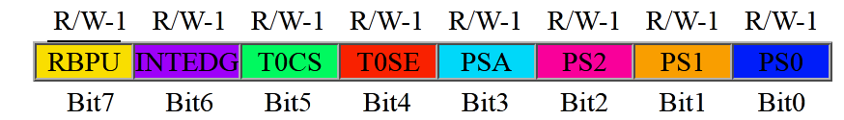
OPTION REGISTAR
bit 7:
RBPU: PORTB Pull-up Enable bit
0 = PORTB pull-ups are disabled
1 = PORTB pull-ups are enabled (by individual port latch values).
bit 6
INTEDG: Interrupt Edge Select bit
1 = Interrupt on rising edge of RB0/INT pin
0 = Interrupt on falling edge of RB0/INT pin

Slide 9
Prekid na RB0
PROCESSOR 16F84
#include "p16f84.inc"
__CONFIG _XT_OSC & _PWRTE_ON & _WDT_OFF & _CP_OFF
org 0x00
goto main
org 0x04
goto ISR
main
bsf STATUS, RP0
movlw b'00000001'
movwf TRISB
bcf OPTION_REG, INTEDG
bsf OPTION_REG, NOT_RBPU
bcf STATUS, RP0
clrf PORTB
bsf PORTB, 7
bsf INTCON, INTE
bsf INTCON, GIE

Slide 10
Prekid na RB0
Loop
goto Loop
ISR
bcf INTCON, INTF
btfss PORTB,7
goto Lab1
bcf PORTB,7
retfie
Lab1
bsf PORTB,7
retfie
end

Slide 11
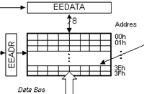
EEPROM MEMORIJA

Slide 12
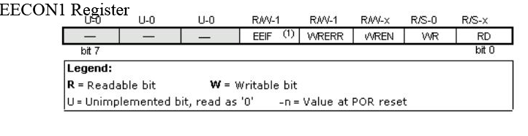
EEPROM MEMORIJA
bit 0 RD (Read Control bit)
1=initializes reading
0=does not initialize reading
bit 3 WRERR (EEPROM Error Flag bit) Error during writing to EEPROM
1=error occured
0=error did not occur
bit 1 WR (Write Control bit)
1=initializes writing
0=does not initialize writing
bit 4 EEIF (EEPROM Write Operation Interrupt Flag bit) Bit used to inform that writing data to EEPROM has ended.
1=writing terminated
0=writing not terminated yet, or has not started
bit 2 WREN (EEPROM Write Enable bit) Enables writing to EEPROM
1=writing allowed
0=writing disallowed

Slide 13
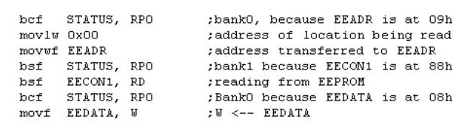
EEPROM MEMORIJA
EEPROM read

Slide 14
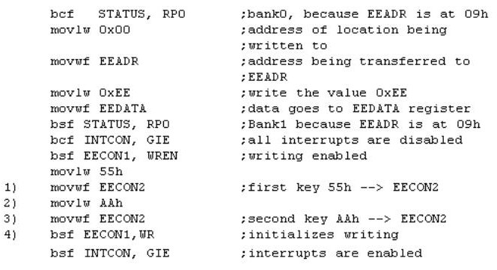
EEPROM MEMORIJA
EEPROM write

Slide 15
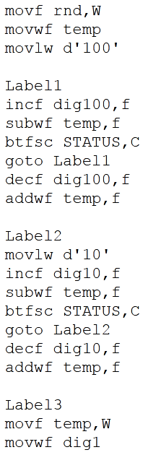
Get digits

