Slide 1
Backpropagation
(hibavisszaterjesztés algoritmus)

Slide 2
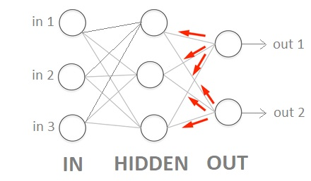
Backpropagation

Slide 3
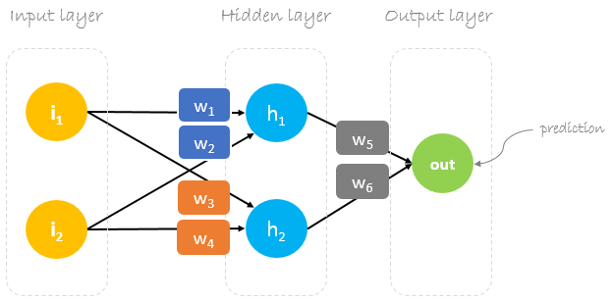

Backpropagation
Random
Initial
Weights

Slide 4
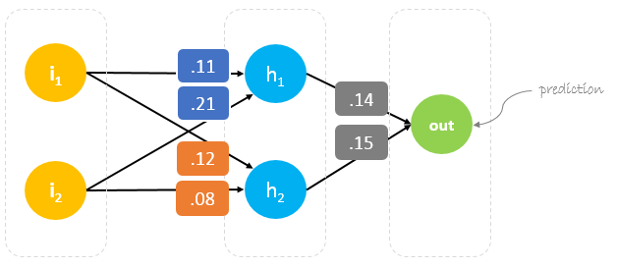
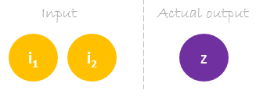
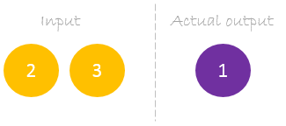
Backpropagation

Slide 5
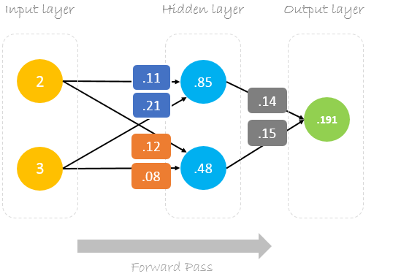
Forward pass
Linear activation
function:
out = in

Slide 6
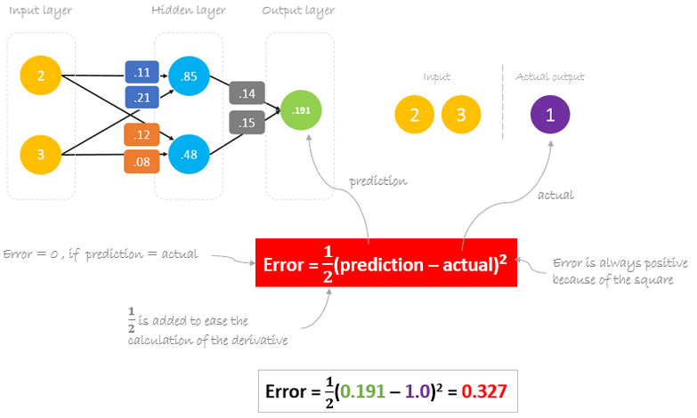
Error calculation

Slide 7
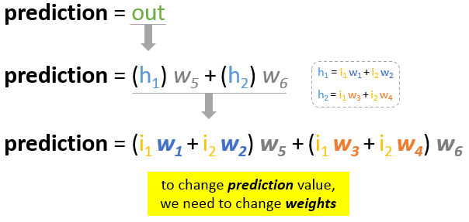
Error reduction

Slide 8
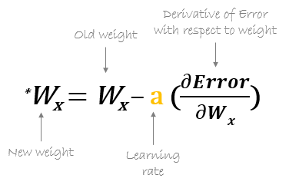

Backpropagation

Slide 9
Partial derivatives - examples

Slide 10
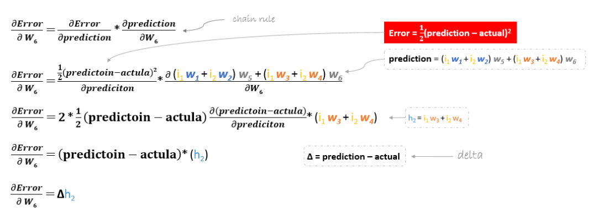


Backpropagation

Slide 11
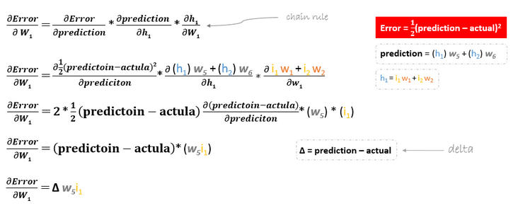
Backpropagation

Slide 12
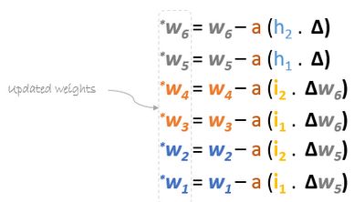

Weight update
= 0.17 (0.15)
= 0.17 (0.14)
= 0.10 (0.08)
= 0.13 (0.12)
= 0.23 (0.21)
= 0.12 (0.11)

Slide 13
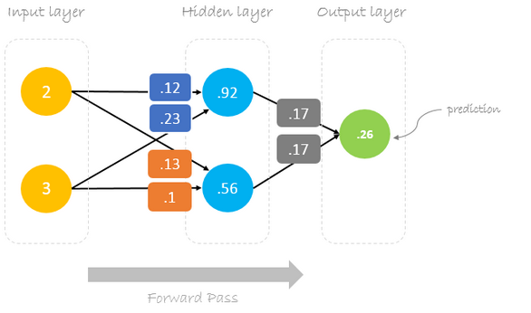
Forward pass

Slide 14
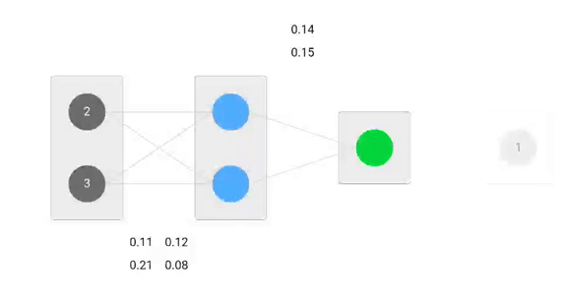
Visualization

