Slide 1
HOW TO START FREELANCING

Slide 2
ABOUT ME
Márton Csernik
Born in 1986
Svetozar Marković High School, SU (2001-2005)
Subotica Tech (Visoka Tehnička Škola Strukovnih Studija), SU (2005-2008)
Worked in a local company for almost 5 years
Full-time freelancer on Elance since 03/2013
  Clients from Canada, the US, the UK, Italy, Sweden
Current employer: LeanStream.ca

Slide 3
WHO IS A FREELANCER

Slide 4
DIFFERENCES BETWEEN
WORKING IN A COMPANY
AND BEING A FREELANCER

Slide 5
WORKING IN A COMPANY
You are a programmer/designer/etc.
You have fixed work hours
You have a steady salary
You have at least one boss, but maybe more

Slide 6
BEING A FREELANCER
You are a programmer/designer/etc.
You are an accountant
You are the sales guy
You are the server guy
You are the support guy
You are the manager
You work when you want OR when you have to
You have a variable (but probably higher!) salary
You have no bosses, only a client

Slide 7
SIMILARITIES BETWEEN WORKING IN A COMPANY AND BEING A FREELANCER
You have to work hard
You have to be good
Know multiple programming languages

Slide 8
BEFORE YOU START…

Slide 9

LEARN THAT ENGLISH

Slide 10
BEGIN WITH
Online portfolios: Website & LinkedIn
Clean up other social networks
Read, investigate, learn, ask, follow
  elitesecurity.org (Freelance Tutorial), ftw.rs, pticek.com, webinarium.rs, startit.rs, mozeiovako.com …
  Darko Vidić, Željko Ptiček, Ivan Minić, Slobodan Marković, Igor Tomić, Zoran Torbica, Istok Pavlović, Dragan Varagić…
Set up a bank account

Slide 11
CHOOSE A PLATFORM
Elance
Odesk
Freelancer
Guru
Hired
gun.io
TopTal
GreenDesign
99designs
RemoteOK
AngelList
Hacker News
…

Slide 12
POPULAR SKILLS IN DEMAND
PHP
JavaScript
Node.js / io.js
HTML, CSS
Java
C
C++
C#
Android, iOS
Ruby
Python

Slide 13

BUILD YOUR PROFILE
A nice photo
Overview, resumé/CV, portfolio
Education
Skill tests
Earlier projects
Job history
Rating, recommendations
Verify credentials

Slide 14
START LOOKING
Pick a category
Look for small, quick tasks in the beginning
Be cheap in the beginning, then raise your rates
Always trust your instincts
Bid on more tasks in the same time
Jobs can be flat rate or hourly rate

Slide 15
JOBS TO AVOID
Payment is not verified
The description is one sentence
Horrible English
When a particular contractor is targeted
More than 10-15 bidders
When the client has no history
When the client gives bad rating and reviews
WordPress plugin updates

Slide 16
AN EFFECTIVE PROPOSAL
A few words about yourself
Describe your idea for solving the problem
Show previous similar jobs
Create and present something quickly
Ask questions to start a conversation
No “Dear Sir”
No $19.72 -> make that $20
No copy-paste proposals

Slide 17
WHEN YOU GET A JOB
Don’t panic
Give your best
If something’s unclear, just ask
Finish in time
Upload to your server
Send the full code when the task is paid
Ask for rating

Slide 18
REMEMBER
Be kind and communicative
Invest in yourself
Have everything written
Have a contract
DON’T GIVE UP, KEEP TRYING
Enjoy

Slide 19
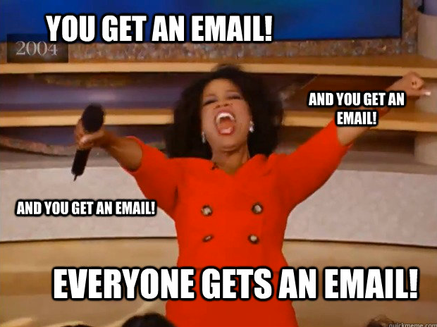
csm@csm.rs
www.csernikmarton.com

Slide 20
QUESTION TIME

